Slide 1
Docker 실습
보라매NOC – 가상화WG

Slide 2
목차
1. docker 이론
2. docker설치/레포지터리
3. docker볼륨/네트워크
4. microservice/lxd

Slide 3
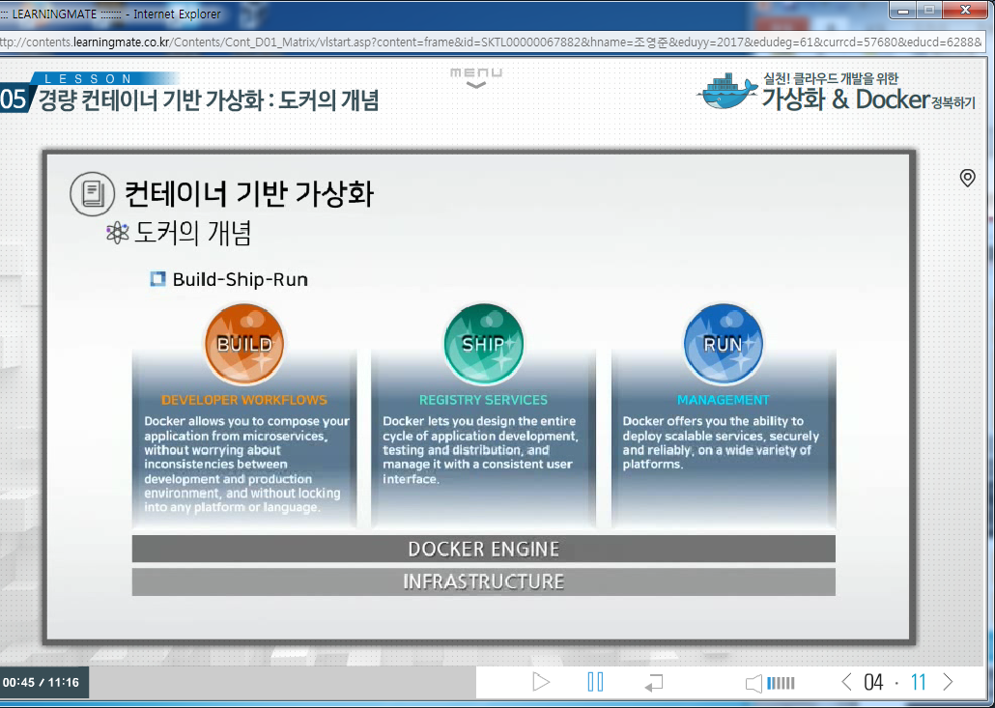
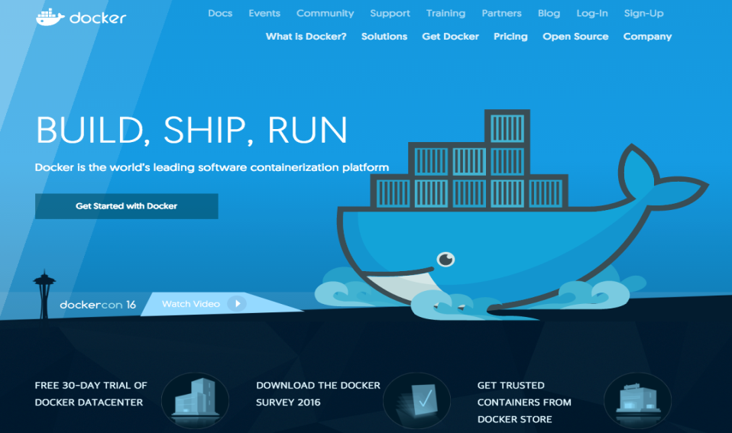
1. docker이론
docker 란 (고래위의 컨테이너 박스)
컨테이너 가상화 기술을 사용하여 application을 개발,이동,실행을 위한 플랫폼
ㅇ BUILD: 프로그램 실행에 필요한 것들을 박스로 포장하고
ㅇ SHIP: 포장된 박스를 손쉽게 이동
ㅇ RUN: 어디서나 간단하게 실행

Slide 4
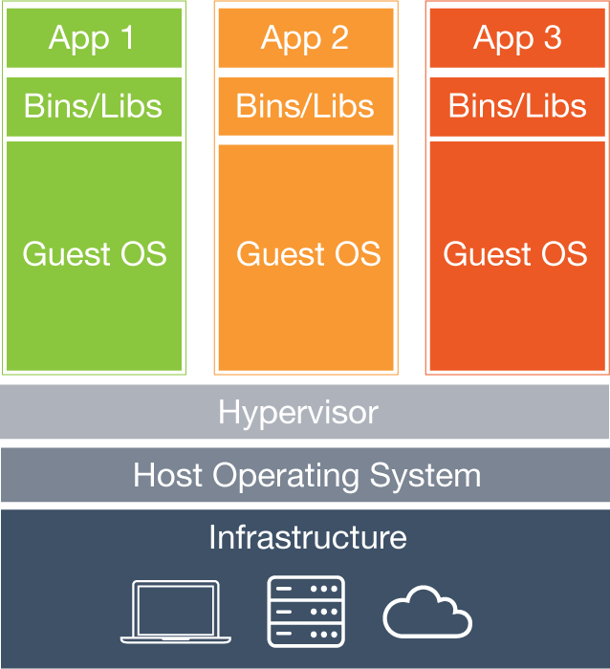
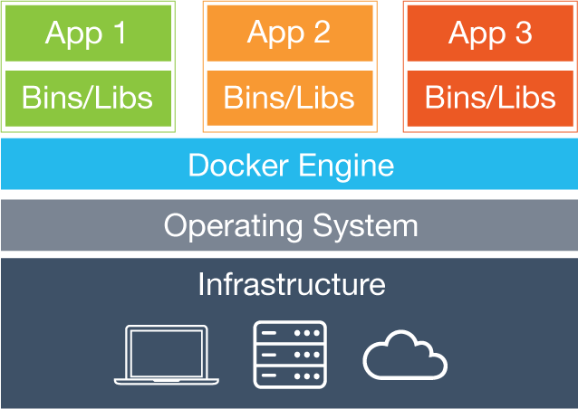
1. docker이론
가상머신 VS Docker
ㅇ가상머신
가. 성능이 좋지 못한 것이 단점. (Native 대비 10~15% 성능저하)
나. 이미지안에 OS가 포함되기 때문에 이미지 용량 증가(DISK공간 차지)
다. 이미지를 생성하는 기능만 가지고 있을 뿐 배포와 관리 기능이 부족
ㅇ Docker
가. Guest OS가 없기 파일시스템, 네트워크 속도도 가상 머신 대비 빠름 (Native 3~5% 성능저하)
나. Docker 이미지에 서버 운영에 필요한 프로그램과 라이브러리만 격리해서 설치할 수 있고,
OS 자원은 호스트와 공유
다. 이미지 생성뿐만 아니라 배포와 실행관련 특화된 기능을 제공 (도커 허브 제공)

Slide 5
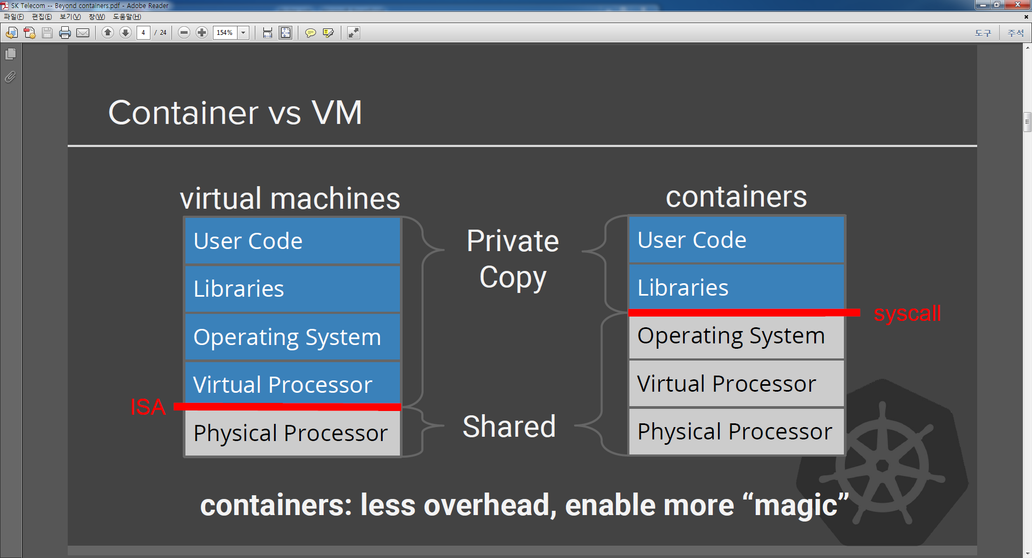
1. docker이론
ㅇ Docker는 가상머신에 비해 Shared 부분이 넓기 때문에 자원을 공유하여 효율적으로 사용
ㅇ Docker는 가성머신에 비해 private 부분이 적기 때문에 다른 곳으로 이식과 배포가 쉬움

Slide 6
1. docker이론
Docker 특징
ㅇ 모든 컨테이너들이 동일 OS 커널 공유
ㅇ 리눅스 특수기능(Libcontainer)를 사용한 실행환경 격리
ㅇ 파일시스템은 Aufs(Advanced multi layered unification filesystem)사용
ㅇ GIT&GITHUB와 같은 이미지 버젼 관리 시스템 도입
ㅇ 2014년 6월 (VER 1.0) 출시후 2017년 4월( VER 17.04)
ㅇ 구글과 같은 Major업계에서 빠른 속도로 채택하여 사실상 컨테이너의 표준이됨
ㅇ GO라는 언어서 작성
ㅇ DotCloud에서 PaaS의 백엔드로 사용한 컨테이너기반 소프트웨어를 오픈소스로 공개
ㅇ 하나의 Linux 시스템에서 여러 Linux(우분투,데비안,수세,레드햇)를 운용가능
ㅇ Dockerfile을 이용해 구성내역과 이력추적이 가능

Slide 7
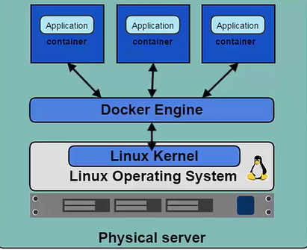

1. docker이론
Docker Engine
가. 도커 컨테이너 생성 및 관리 제공을 위한 프로그램
가. 리눅스 커널 namespace와 control group를 사용한다
나. 다양한 namesapce는(PID,NET,IPC,MNT,UTS)를 사용하여 격리된 작업공간을 제공
2. Server/Client 구조
가. 서버/클라이언트 구조
가. 클라이언트의 요청을 받아 서버가 컨테이너를 생성 및 배포 작업등을 진행
나. 클라이언트는 서버와 같은 호스트 또는 다른 호스트에 있을수 있다
라. CLI 클라이언트와 GUI(Kitematic)을 제공
[root@salt-master Desktop]# docker version
Client:
Version: 1.8.2-el7.centos
API version: 1.20
Package Version: docker-1.8.2-10.el7.centos.x86_64
Go version: go1.4.2
Git commit: a01dc02/1.8.2
Built:
OS/Arch: linux/amd64
Server:
Version: 1.8.2-el7.centos
API version: 1.20
Package Version:
Go version: go1.4.2
Git commit: a01dc02/1.8.2
Built:
OS/Arch: linux/amd64

Slide 8
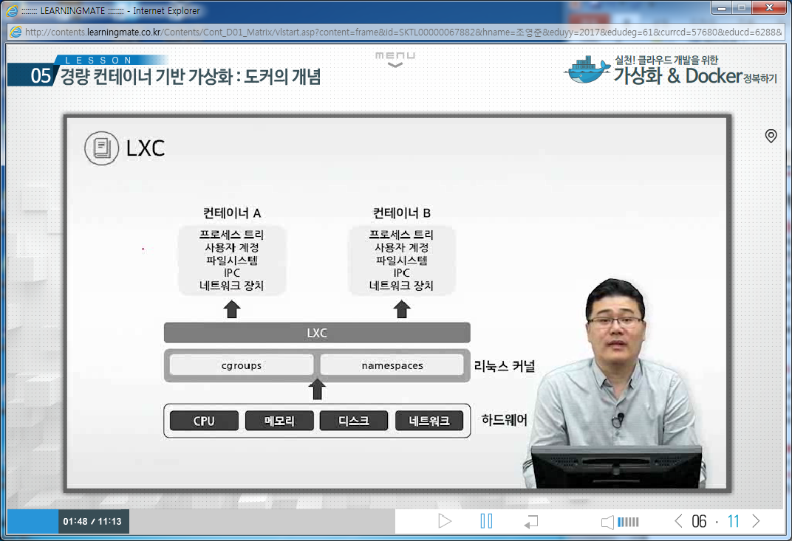
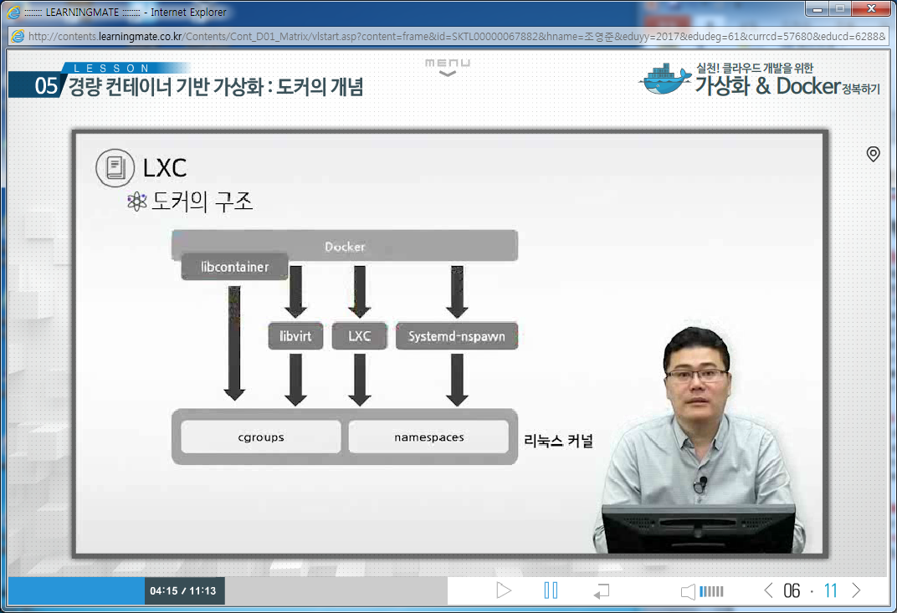
1. docker이론
1. Docker 기술
Namespaces (docker exec contaniner_id, 호스트와 별개의 공간설정)
Docker takes advantage of a technology called namespaces to provide the isolated workspace we call the container. When you run a container, Docker creates a set of namespaces for that container.
This provides a layer of isolation: each aspect of a container runs in its own namespace and does not have access outside it.
Some of the namespaces that Docker uses on Linux are:
The pid namespace: Used for process isolation (PID: Process ID).
The net namespace: Used for managing network interfaces (NET: Networking).
The ipc namespace: Used for managing access to IPC resources (IPC: InterProcess Communication).
The mnt namespace: Used for managing mount-points (MNT: Mount).
The uts namespace: Used for isolating kernel and version identifiers. (UTS: Unix Timesharing System).
Control groups (systemd-cgls, CPU/MEM/DISK/NETOWORK 프로비져닝)
Docker on Linux also makes use of another technology called cgroups or control groups. A key to running applications in isolation is to have them only use the resources you want. This ensures containers are good multi-tenant citizens on a host. Control groups allow Docker to share available hardware resources to containers and, if required, set up limits and constraints. For example, limiting the memory available to a specific container.
Union file systems (docker info , 파일을 공유하고 다른부분만 관리하는 파일시스템)
Union file systems, or UnionFS, are file systems that operate by creating layers, making them very lightweight and fast. Docker uses union file systems to provide the building blocks for containers. Docker can make use of several union file system variants including: AUFS, btrfs, vfs, and DeviceMapper

Slide 9
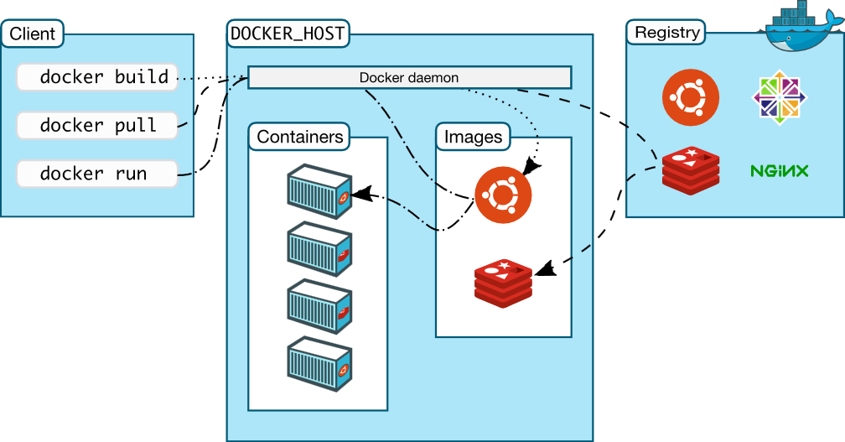
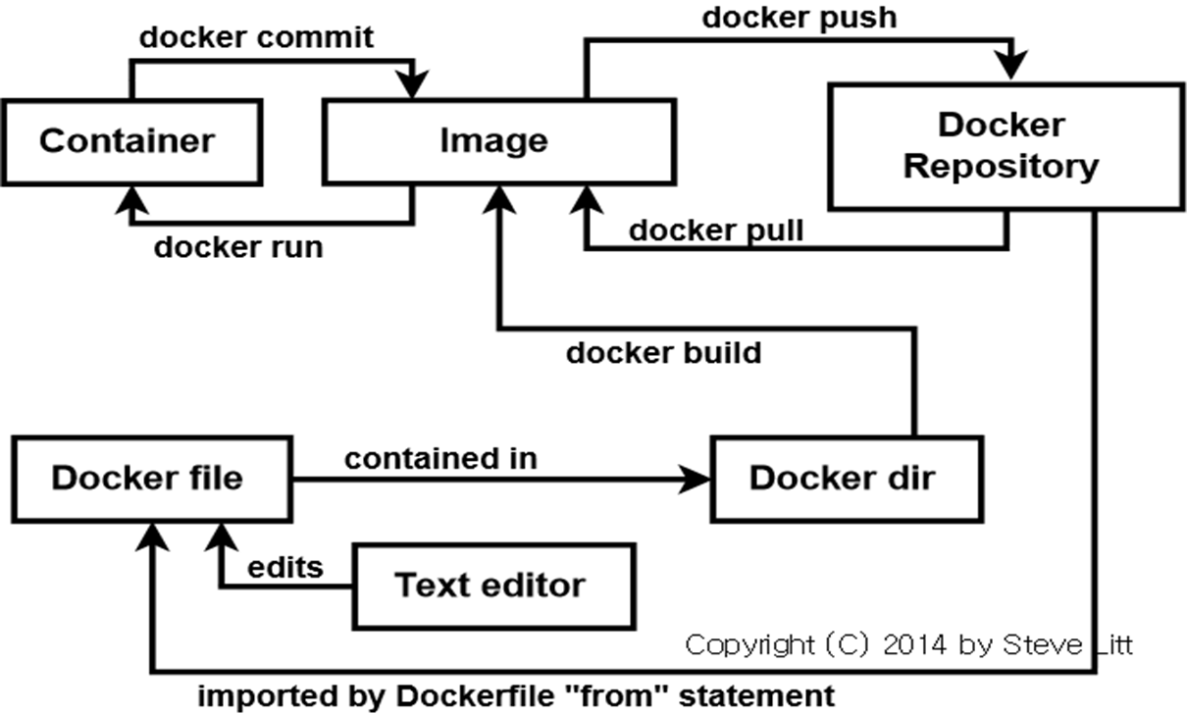
1. docker이론
Docker 이미지와 컨테이너
ㅇ도커 이미지
가. 이미지는 필요한 프로그램과 라이브러리, 소스를 설치한 template 파일
나. Docker Hub 또는 local Registry에 저장
다. OS에서 입장에서는 이미지는 실행파일
ㅇ 도커 컨테이너
가. 격리된 application platform
나. 컨테이너는 이미지를 실행한 상태입니다. (하나의 이미지로 다수 컨테이너를 생성)
다. OS에서 입장에서는 컨테이너는 프로세스

Slide 10
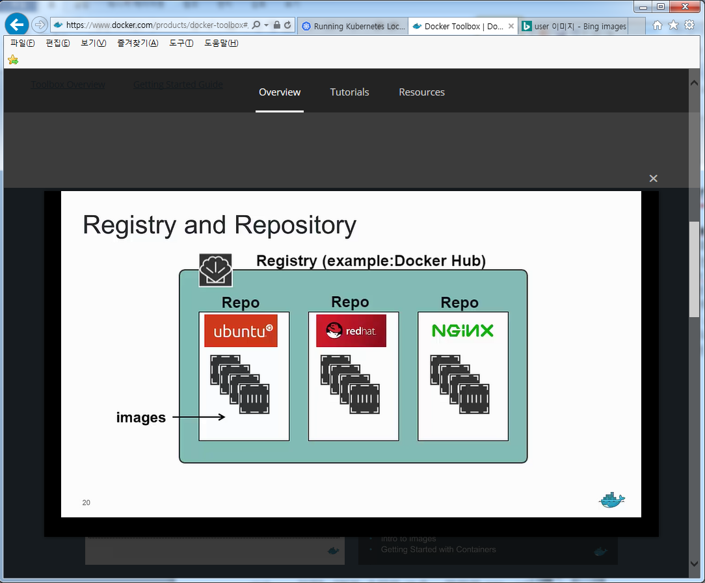
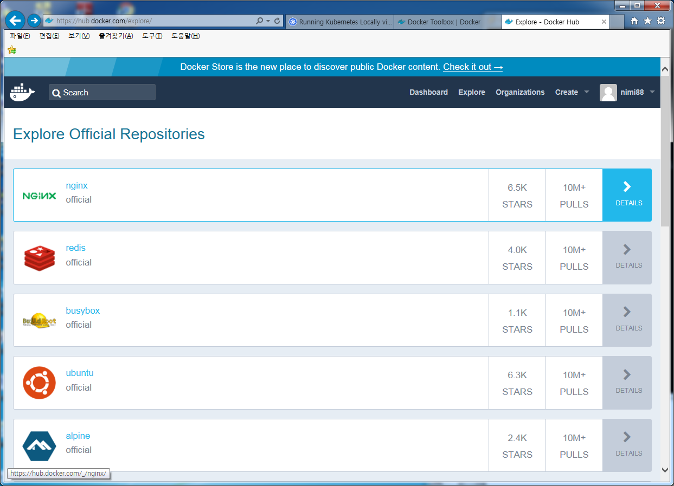
1. docker이론
Docker Registry와 Repository
ㅇ도커 레지스터리
가. Docker Hub 또는 local Registry가 있음
나. Docker Hub는 공용 registry로 수 많은 이지미를 포함
다. 다른 registry가 등록되어 있지 않으면 Docker Hub에서 이미지를 찾음
ㅇ 도커 리포지터리
가. 하나의 레지스터리에 다양한 repo가 존재함
나. 하나의 repo에 다양한 버젼의 image들이 존재함

Slide 11
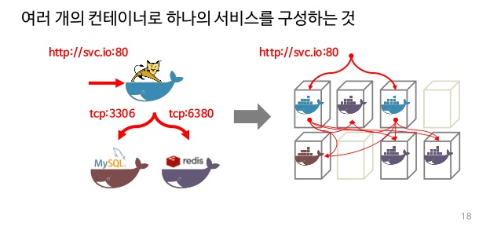
1. docker이론
Docker Orchestration
ㅇ도커 오케스트레이션
가. Docker Compose : 멀티 컨테이너 생성 및 관리 툴
나. Docker Swarm : 도커엔진을 클러스터화 하고 컨테이너를 스케줄하는 하는 툴
다. Docker Kubernetes : Pod를 사용하여 서비스를 패키징하여 배포하는 툴

Slide 12
1. docker설치
1. docker 설치
[root@salt-master ~]# yum install docker
Loaded plugins: fastestmirror, langpacks
Repository '--help': Error parsing config: Error parsing "baseurl = '--help'": URL must be http, ftp, file or https not ""
Loading mirror speeds from cached hostfile
* base: ftp.neowiz.com
* extras: ftp.neowiz.com
* updates: ftp.neowiz.com
Resolving Dependencies
--> Running transaction check
---> Package docker.x86_64 0:1.8.2-10.el7.centos will be installed
--> Finished Dependency Resolution
Dependencies Resolved
=============================================================================================================
Package Arch Version Repository Size
=============================================================================================================
Installing:
docker x86_64 1.8.2-10.el7.centos extras 10 M
Transaction Summary
=============================================================================================================
Install 1 Package
Total download size: 10 M
Installed size: 46 M
Is this ok [y/d/N]: y
Downloading packages:
docker-1.8.2-10.el7.centos.x86_64.rpm | 10 MB 00:00:02
Running transaction check
Running transaction test
Transaction test succeeded
Running transaction
Installing : docker-1.8.2-10.el7.centos.x86_64 1/1
Verifying : docker-1.8.2-10.el7.centos.x86_64 1/1
Installed:
docker.x86_64 0:1.8.2-10.el7.centos

Slide 13
1. docker설치
1. docker 시작
[root@salt-master ~]# systemctl start docker
[root@salt-master ~]# systemctl enable docker
[root@salt-master ~]# systemctl status docker
● docker.service - Docker Application Container Engine
Loaded: loaded (/usr/lib/systemd/system/docker.service; disabled; vendor preset: disabled)
Active: active (running) since Thu 2016-03-24 02:09:23 EDT; 6s ago
Docs: http://docs.docker.com
Main PID: 15210 (docker)
CGroup: /system.slice/docker.service
└─15210 /usr/bin/docker daemon --selinux-enabled
Mar 24 02:09:23 salt-master docker[15210]: time="2016-03-24T02:09:23.527414068-04:00" level=info msg="...r\""
Mar 24 02:09:23 salt-master docker[15210]: time="2016-03-24T02:09:23.538144899-04:00" level=info msg="...dge"
Mar 24 02:09:23 salt-master docker[15210]: time="2016-03-24T02:09:23.538177022-04:00" level=info msg="...dge"
Mar 24 02:09:23 salt-master docker[15210]: time="2016-03-24T02:09:23.559789385-04:00" level=warning ms...s 1"
Mar 24 02:09:23 salt-master docker[15210]: time="2016-03-24T02:09:23.584046221-04:00" level=info msg="...rue"
Mar 24 02:09:23 salt-master docker[15210]: time="2016-03-24T02:09:23.906945933-04:00" level=info msg="...rt."
Mar 24 02:09:23 salt-master docker[15210]: time="2016-03-24T02:09:23.907135397-04:00" level=info msg="...ne."
Mar 24 02:09:23 salt-master docker[15210]: time="2016-03-24T02:09:23.907151152-04:00" level=info msg="...ion"
Mar 24 02:09:23 salt-master docker[15210]: time="2016-03-24T02:09:23.907169650-04:00" level=info msg="...ntos
Mar 24 02:09:23 salt-master systemd[1]: Started Docker Application Container Engine.
Hint: Some lines were ellipsized, use -l to show in full.
[root@salt-master ~]# ps -ef | grep docker
root 15210 1 0 02:09 ? 00:00:00 /usr/bin/docker daemon --selinux-enabled
root 15314 14861 0 02:09 pts/2 00:00:00 grep --color=auto docker
[root@salt-master ~]# ifconfig
docker0: flags=4099<UP,BROADCAST,MULTICAST> mtu 1500
inet 172.17.42.1 netmask 255.255.0.0 broadcast 0.0.0.0
ether 02:42:b9:53:56:de txqueuelen 0 (Ethernet)
RX packets 0 bytes 0 (0.0 B)
RX errors 0 dropped 0 overruns 0 frame 0
TX packets 0 bytes 0 (0.0 B)
TX errors 0 dropped 0 overruns 0 carrier 0 collisions 0

Slide 14
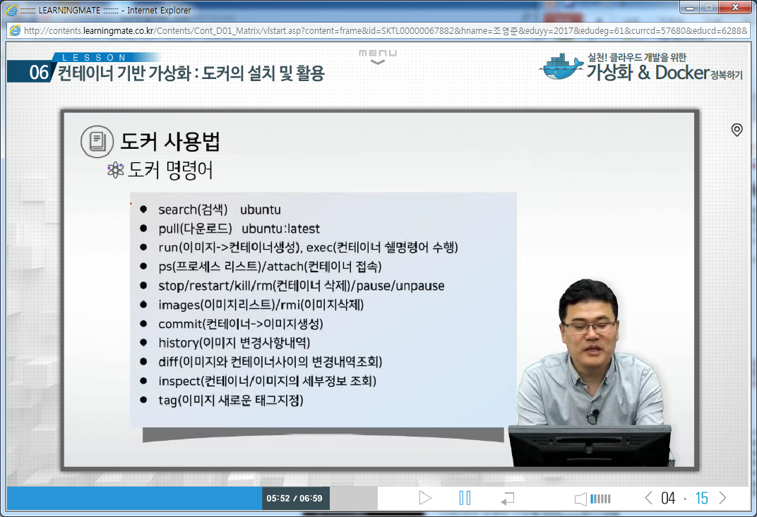
1. docker설치
1. docker help명령어
root@salt-master Desktop]# docker --help
Usage: docker [OPTIONS] COMMAND [arg...]
docker daemon [ --help | ... ]
docker [ --help | -v | --version ]
A self-sufficient runtime for containers.
Options:
--config=~/.docker Location of client config files
-D, --debug=false Enable debug mode
-H, --host=[] Daemon socket(s) to connect to
-h, --help=false Print usage
-l, --log-level=info Set the logging level
--tls=false Use TLS; implied by --tlsverify
--tlscacert=~/.docker/ca.pem Trust certs signed only by this CA
--tlscert=~/.docker/cert.pem Path to TLS certificate file
--tlskey=~/.docker/key.pem Path to TLS key file
--tlsverify=false Use TLS and verify the remote
-v, --version=false Print version information and quit
Commands:
attach Attach to a running container
build Build an image from a Dockerfile
commit Create a new image from a container's changes
cp Copy files/folders from a container to a HOSTDIR or to STDOUT
create Create a new container
diff Inspect changes on a container's filesystem
events Get real time events from the server

Slide 15
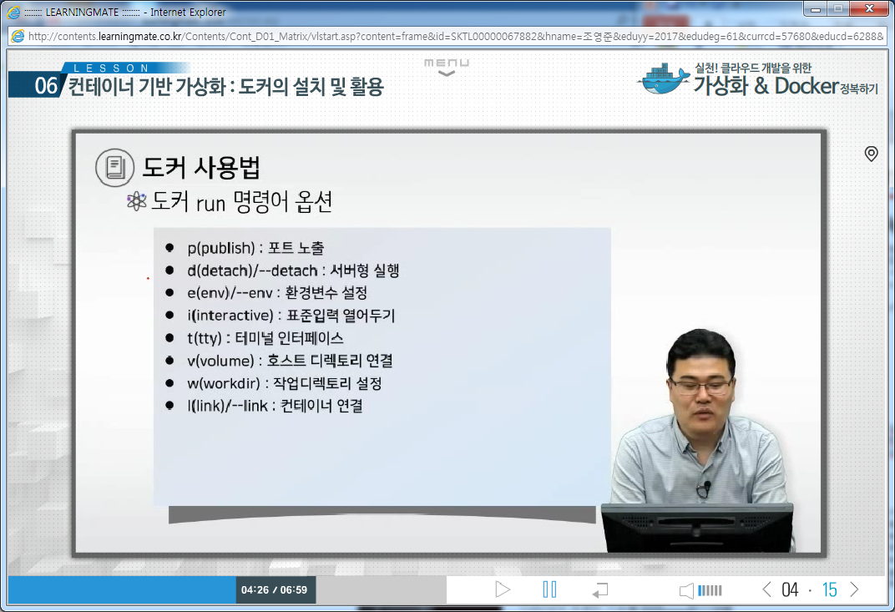
1. docker설치
1. docker run help명령어
[root@localhost ~]# docker run --help
Usage: docker run [OPTIONS] IMAGE [COMMAND] [ARG...]
Run a command in a new container
Options:
--add-host value Add a custom host-to-IP mapping (host:ip) (default [])
-a, --attach value Attach to STDIN, STDOUT or STDERR (default [])
--blkio-weight value Block IO (relative weight), between 10 and 1000
--blkio-weight-device value Block IO weight (relative device weight) (default [])
--cap-add value Add Linux capabilities (default [])
--cap-drop value Drop Linux capabilities (default [])
--cgroup-parent string Optional parent cgroup for the container
--cidfile string Write the container ID to the file
--cpu-percent int CPU percent (Windows only)
--cpu-period int Limit CPU CFS (Completely Fair Scheduler) period
--cpu-quota int Limit CPU CFS (Completely Fair Scheduler) quota
-c, --cpu-shares int CPU shares (relative weight)
--cpuset-cpus string CPUs in which to allow execution (0-3, 0,1)
--cpuset-mems string MEMs in which to allow execution (0-3, 0,1)
-d, --detach Run container in background and print container ID
--detach-keys string Override the key sequence for detaching a container
--device value Add a host device to the container (default [])
--device-read-bps value Limit read rate (bytes per second) from a device (default [])
--device-read-iops value Limit read rate (IO per second) from a device (default [])
--device-write-bps value Limit write rate (bytes per second) to a device (default [])
--device-write-iops value Limit write rate (IO per second) to a device (default [])
--disable-content-trust Skip image verification (default true)
--dns value Set custom DNS servers (default [])
--dns-opt value Set DNS options (default [])
--dns-search value Set custom DNS search domains (default [])
--entrypoint string Overwrite the default ENTRYPOINT of the image
-e, --env value Set environment variables (default [])
--env-file value Read in a file of environment variables (default [])
--expose value Expose a port or a range of ports (default [])
--group-add value Add additional groups to join (default [])
--health-cmd string Command to run to check health
--health-interval duration Time between running the check (default 0s)
--health-retries int Consecutive failures needed to report unhealthy
--health-timeout duration Maximum time to allow one check to run (default 0s)
--help Print usage
-h, --hostname string Container host name
-i, --interactive Keep STDIN open even if not attached
--io-maxbandwidth string Maximum IO bandwidth limit for the system drive (Windows only)
--io-maxiops uint Maximum IOps limit for the system drive (Windows only)
--ip string Container IPv4 address (e.g. 172.30.100.104)
--ip6 string Container IPv6 address (e.g. 2001:db8::33)
--ipc string IPC namespace to use
--isolation string Container isolation technology
--kernel-memory string Kernel memory limit
-l, --label value Set meta data on a container (default [])
--label-file value Read in a line delimited file of labels (default [])
--link value Add link to another container (default [])
--link-local-ip value Container IPv4/IPv6 link-local addresses (default [])
--log-driver string Logging driver for the container
--log-opt value Log driver options (default [])
--mac-address string Container MAC address (e.g. 92:d0:c6:0a:29:33)
-m, --memory string Memory limit
--memory-reservation string Memory soft limit
--memory-swap string Swap limit equal to memory plus swap: '-1' to enable unlimited swap
--memory-swappiness int Tune container memory swappiness (0 to 100) (default -1)
--name string Assign a name to the container
--network string Connect a container to a network (default "default")
--network-alias value Add network-scoped alias for the container (default [])
--no-healthcheck Disable any container-specified HEALTHCHECK
--oom-kill-disable Disable OOM Killer
--oom-score-adj int Tune host's OOM preferences (-1000 to 1000)
--pid string PID namespace to use
--pids-limit int Tune container pids limit (set -1 for unlimited)
--privileged Give extended privileges to this container
-p, --publish value Publish a container's port(s) to the host (default [])
-P, --publish-all Publish all exposed ports to random ports
--read-only Mount the container's root filesystem as read only
--restart string Restart policy to apply when a container exits (default "no")
--rm Automatically remove the container when it exits
--runtime string Runtime to use for this container
--security-opt value Security Options (default [])
--shm-size string Size of /dev/shm, default value is 64MB
--sig-proxy Proxy received signals to the process (default true)
--stop-signal string Signal to stop a container, SIGTERM by default (default "SIGTERM")
--storage-opt value Storage driver options for the container (default [])
--sysctl value Sysctl options (default map[])
--tmpfs value Mount a tmpfs directory (default [])
-t, --tty Allocate a pseudo-TTY
--ulimit value Ulimit options (default [])
-u, --user string Username or UID (format: <name|uid>[:<group|gid>])
--userns string User namespace to use
--uts string UTS namespace to use
-v, --volume value Bind mount a volume (default [])
--volume-driver string Optional volume driver for the container
--volumes-from value Mount volumes from the specified container(s) (default [])
-w, --workdir string Working directory inside the container

Slide 16
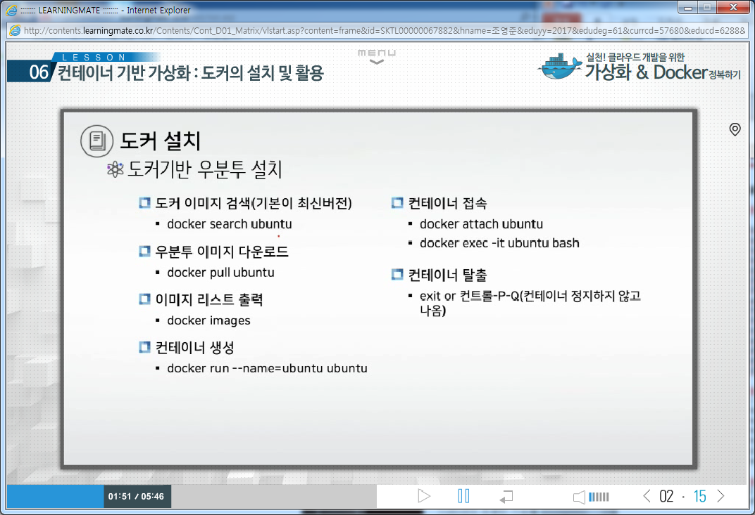
1. docker 설치
1. docker기반 ubuntu컨테이너설치

Slide 17
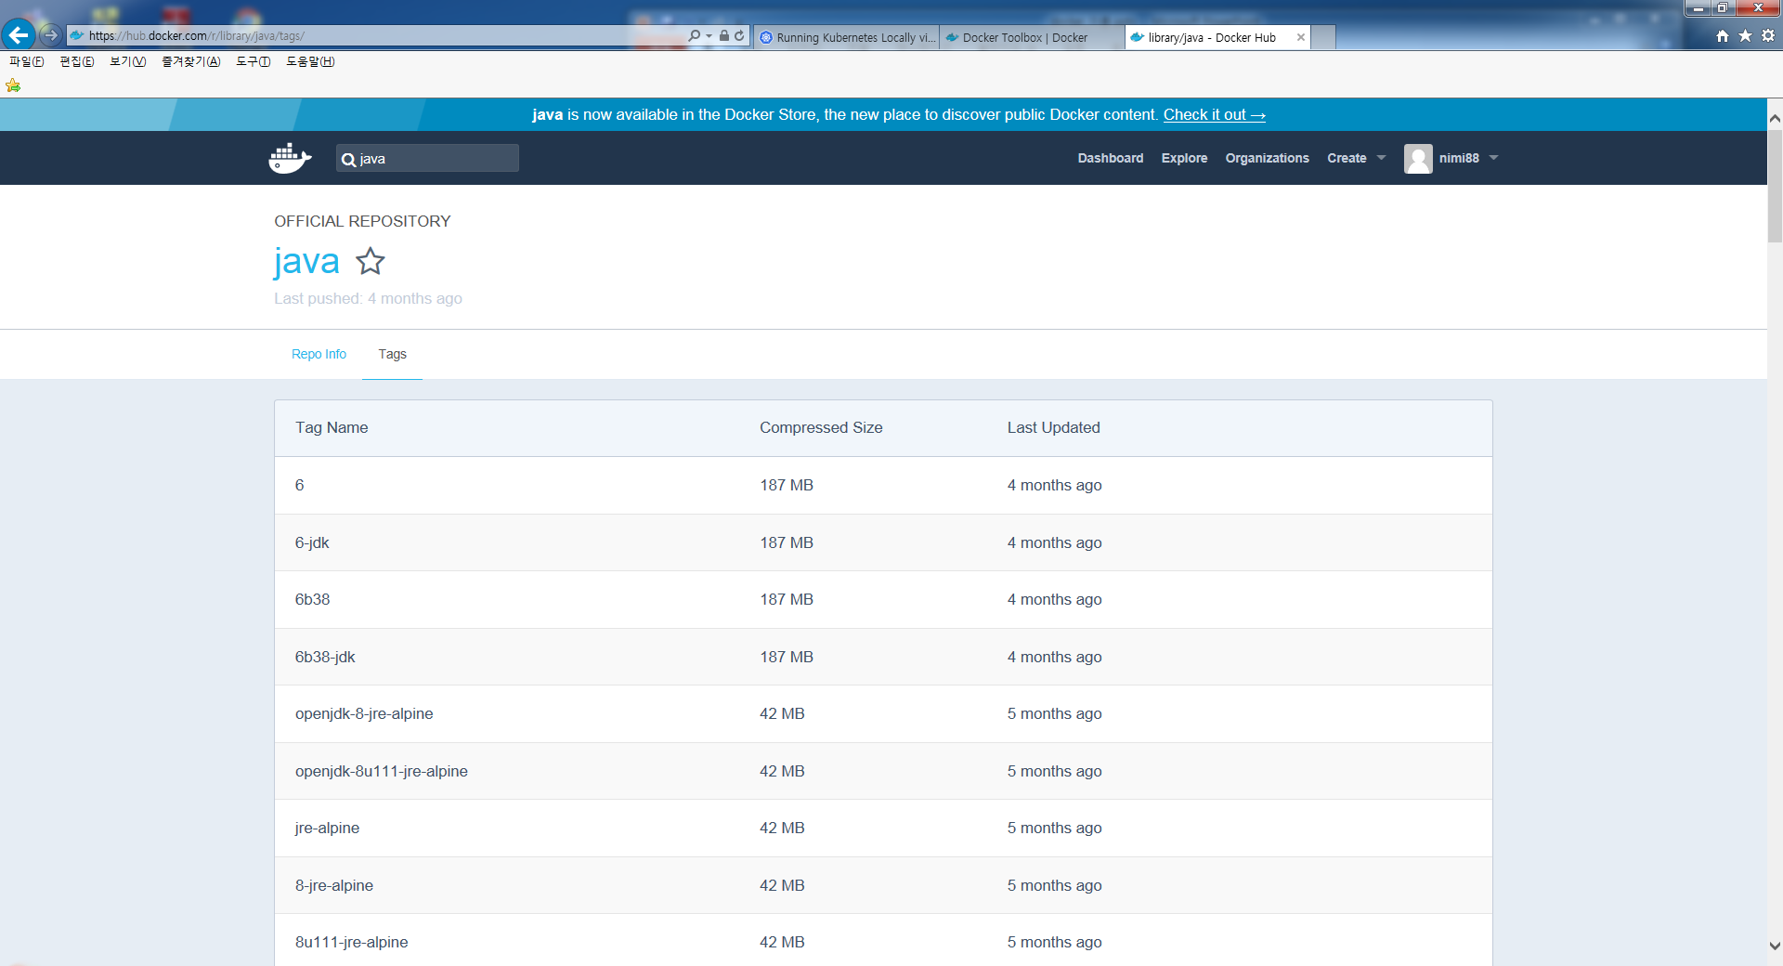
1. docker 이미지
Docker 이미지 Tags
가. 이미지는 repository:tag로 고유한 ID를 생성한다.
나. 같은 이미지도 다수의 tag를 가질수 있다.
다. default tag는 latest
라. 다운로드 받은 이미지로 컨테이너를 구동할 경우 다운로드 불필요하므로 구동시간이 짧음

Slide 18
1. docker 이미지
1. docker image
[root@salt-master ~]# docker search ubuntu
INDEX NAME DESCRIPTION STARS OFFICIAL AUTOMATED
docker.io docker.io/ubuntu Ubuntu is a Debian-based Linux operating s... 3480 [OK]
docker.io docker.io/ubuntu-upstart Upstart is an event-based replacement for ... 60 [OK]
docker.io docker.io/torusware/speedus-ubuntu Always updated official Ubuntu docker imag... 25 [OK]
docker.io docker.io/ubuntu-debootstrap debootstrap --variant=minbase --components... 24 [OK]
docker.io docker.io/rastasheep/ubuntu-sshd Dockerized SSH service, built on top of of... 23 [OK]
docker.io docker.io/nickistre/ubuntu-lamp LAMP server on Ubuntu 6 [OK]
docker.io docker.io/nickistre/ubuntu-lamp-wordpress LAMP on Ubuntu with wp-cli installed 5 [OK]
docker.io docker.io/nuagebec/ubuntu Simple always updated Ubuntu docker images... 4 [OK]
docker.io docker.io/nimmis/ubuntu This is a docker images different LTS vers... 3 [OK]
docker.io docker.io/consol/sakuli-ubuntu-xfce Sakuli end-2-end testing and monitoring co... 2 [OK]
docker.io docker.io/densuke/ubuntu-jp-remix Ubuntu Linuxの日本語remix風味です 2 [OK]
docker.io docker.io/maxexcloo/ubuntu Docker base image built on Ubuntu with Sup... 2 [OK]
docker.io docker.io/avatao/ubuntu Ubuntu for challenges 1 [OK]
docker.io docker.io/darksheer/ubuntu Base Ubuntu Image -- Updated hourly 1 [OK]
docker.io docker.io/jordi/ubuntu Ubuntu Base Image 1 [OK]
[root@salt-master ~]# docker pull ubuntu:latest
Trying to pull repository docker.io/library/ubuntu ... latest: Pulling from library/ubuntu
808ef855e5b6: Pull complete
267903aa9bd1: Pull complete
d28d8a6a946d: Pull complete
ab035c88d533: Pull complete
Digest: sha256:1bea66e185d3464fec1abda32ffaf2a11de69833cfcf81bd2b9a5be147776814
Status: Downloaded newer image for docker.io/ubuntu:latest
[root@salt-master ~]# docker images
REPOSITORY TAG IMAGE ID CREATED VIRTUAL SIZE
docker.io/ubuntu latest ab035c88d533 5 days ago 187.9 MB

Slide 19
1. docker 이미지
1. docker 실행 및 접속
[root@salt-master ~]# docker run -it --name hello ubuntu /bin/bash -> i(interactive), -t(Pseudo-tty) 옵션을 사용하면 실행된 Bash Shell 실행
root@f03772b9ae1a:/# cat /proc/version
Linux version 3.10.0-327.10.1.el7.x86_64 (builder@kbuilder.dev.centos.org) (gcc version 4.8.3 20140911 (Red Hat 4.8.3-9) (GCC) ) #1 SMP Tue Feb 16 17:03:50 UTC 2016
ctrl+D 또는 exit (컨테이너를 stop시켜면서 빠져나옴)
[root@salt-master ~]# docker ps -a
docker: "ps" requires 0 arguments.
[root@salt-master ~]# docker start hello
hello
[root@salt-master ~]# docker attach hello
root@f03772b9ae1a:/# ps
PID TTY TIME CMD
1 ? 00:00:00 bash
14 ? 00:00:00 ps
Ctrl+p + q (컨테이너를 유지하면서 빠져나옴)
[root@salt-master ~]# docker exec -it f03772b9ae1a /bin/bash → exec command는 추가적인 process를 실행시킴
root@c9861a51faea:/# ps -ef | grep bash
root 1 0 0 13:09 ? 00:00:00 /bin/bash
root 15 0 0 13:11 ? 00:00:00 /bin/bash

Slide 20
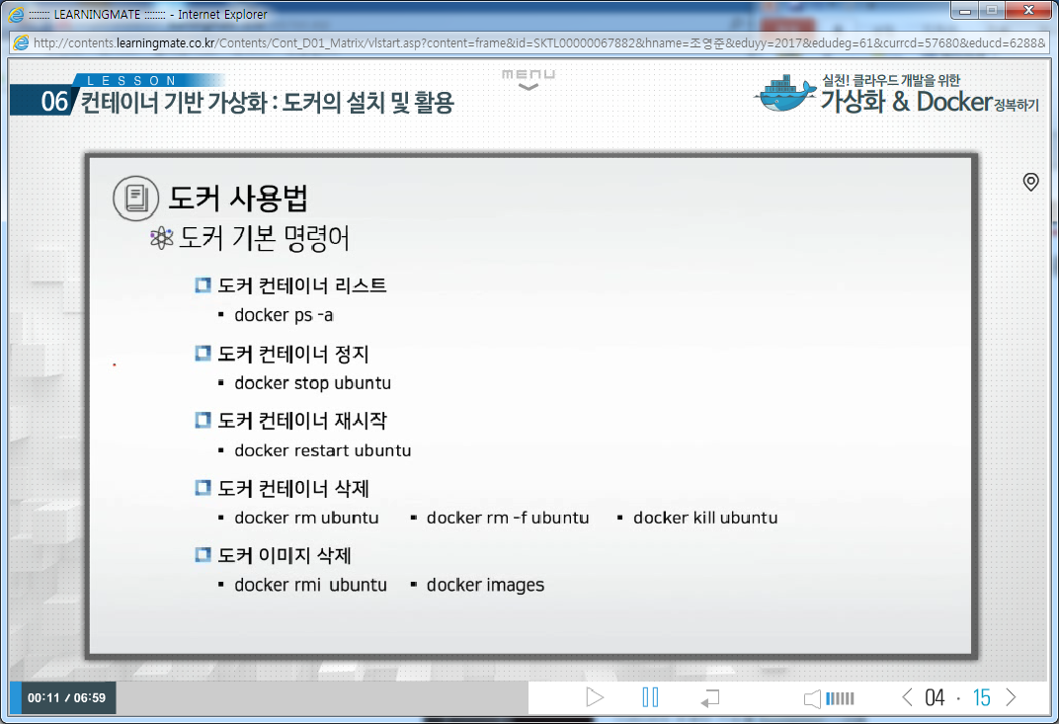
1. docker
docker 기본명령어
가. Docker 컨테이너가 동작하고 있으면 삭제할수 없음
나. Docker 컨테이너가 모두 삭제되있지 않으면 해당 이미지를 삭제할수 없음
docker kill ubuntu

Slide 21
1. docker
1. docker 삭제
[[root@salt-master nginx]# docker ps
CONTAINER ID IMAGE COMMAND CREATED STATUS PORTS NAMES
a21a340f640c nginx "nginx" 4 seconds ago Up 3 seconds 80/tcp focused_bhaskara
ff8e3dcd8b59 wordpress "/bin/sh -c /entrypoi" 3 hours ago Up 3 hours 0.0.0.0:80->80/tcp example-wp
3d2f5501f515 mysql "/bin/sh -c /entrypoi" 3 hours ago Up 3 hours 3306/tcp db
[root@salt-master nginx]# docker stop a21a340f640c
a21a340f640c
[root@salt-master nginx]# docker ps -a
CONTAINER ID IMAGE COMMAND CREATED STATUS PORTS NAMES
a21a340f640c nginx "nginx" 29 seconds ago Exited (0) 12 seconds ago focused_bhaskara
503c7721442e 353936cec1c9 "/bin/bash" 8 minutes ago Exited (127) About a minute ago modest_mayer
ff8e3dcd8b59 wordpress "/bin/sh -c /entrypoi" 3 hours ago Up 3 hours 0.0.0.0:80->80/tcp example-wp
3d2f5501f515 mysql "/bin/sh -c /entrypoi" 3 hours ago Up 3 hours 3306/tcp db
e2388111e147 ubuntu:latest "/bin/bash" 4 hours ago Exited (0) 3 hours ago web1
d0cca2a2b793 ubuntu:latest "/bin/bash" 5 hours ago Created web
[root@salt-master nginx]# docker rm a21a340f640c
a21a340f640c
[root@salt-master nginx]# docker images
REPOSITORY TAG IMAGE ID CREATED VIRTUAL SIZE
nginx latest da6aac6f5de6 10 minutes ago 393.5 MB
wordpress latest 705c483659f5 3 hours ago 308.6 MB
mysql latest 817e0842b929 3 hours ago 344.8 MB
fideloper/docker-example 0.1 728669b79d0b 5 hours ago 372.5 MB
docker.io/ubuntu 14.04 ab035c88d533 7 days ago 187.9 MB
[root@salt-master nginx]# docker rmi nginx
Untagged: nginx:latest
Deleted: da6aac6f5de6764b7b73bd62043b3c678fea69b8ed35529210ac5b5e7b68d8b5
Deleted: 1e17fa0b8e838d0fc51664968f023a05fa7d71468245b9ef945a31debdaad664
Deleted: 9940a0310f0f30db550d1a5b779e11efbcb7eeac0b2717c6ef14ebd9a328b52d
Deleted: 518ef7bd1d093a27044dc3a93a208171f6483ebeed90345b96e3aa419593a0af

Slide 22
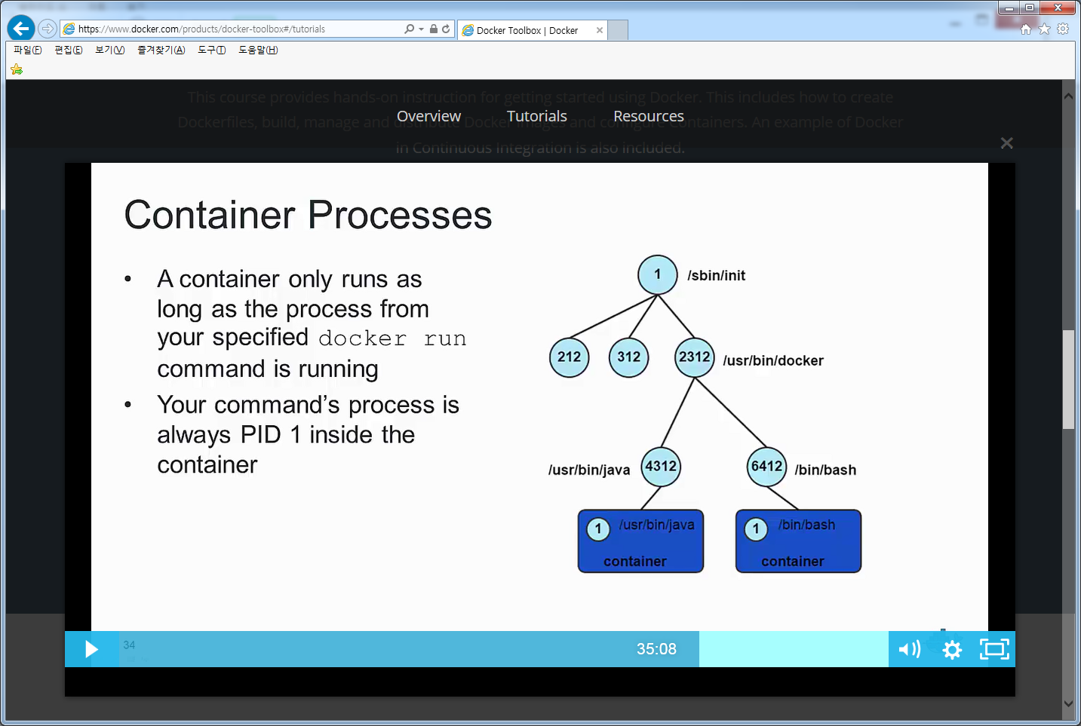
1. docker
1. Docker Process
docker내 PID가 1인 Process가 죽으면 도커 컨테이너도 죽음
[root@localhost ~]# ps -ef | grep docker
root 20489 1 0 06:11 ? 00:00:11 /usr/bin/dockerd-current --add-runtime docker-runc=/usr/libexec/docker/docker-runc-current --default-runtime=docker-runc --exec-opt native.cgroupdriver=systemd --userland-proxy-path=/usr/libexec/docker/docker-proxy-current --selinux-enabled --log-driver=journald --signature-verification=false
root 20492 20489 0 06:11 ? 00:00:00 /usr/bin/docker-containerd-current -l unix:///var/run/docker/libcontainerd/docker-containerd.sock --shim docker-containerd-shim --metrics-interval=0 --start-timeout 2m --state-dir /var/run/docker/libcontainerd/containerd --runtime docker-runc --runtime-args --systemd-cgroup=true
root 26354 20492 0 08:45 ? 00:00:00 /usr/bin/docker-containerd-shim-current c9861a51faeab55da6353eb5cd18d4226a1f6379c90e302299e7549886ef5415 /var/run/docker/libcontainerd/c9861a51faeab55da6353eb5cd18d4226a1f6379c90e302299e7549886ef5415 /usr/libexec/docker/docker-runc-current
[root@localhost ~]# ps -ef | grep /bin/bash
root 26365 26354 0 08:45 pts/1 00:00:00 /bin/bash
[root@localhost ~]# docker attach c9861a51faea
root@c9861a51faea:/# ps -ef
UID PID PPID C STIME TTY TIME CMD
root 1 0 0 12:45 ? 00:00:00 /bin/bash
root 16 1 0 13:07 ? 00:00:00 ps -ef

Slide 23
1. docker
Docker 디렉토리 구조
ㅇ도커 디렉토리
가. libcontainerd :
나. libnetwork :
다. netns :
[root@localhost netns]# ll /var/run/docker
total 0
drwx------. 4 root root 140 Jul 3 09:09 libcontainerd
drw-------. 2 root root 60 Jul 3 06:11 libnetwork
drwxr-xr-x. 2 root root 60 Jul 3 09:09 netns

Slide 24
1. docker
Docker 컨테이너 ID
ㅇ도커 컨테이너 ID
가. 컨테이너를 지정하기 위해 ID 또는 name을 사용
나. Short ID와 name은 docker ps –a로 확인
다. name은 지정하지 않으면 docker가 임의로 name으로 생성함
라. Long ID는 docker inspect short id로 조회시 확인가능
[root@localhost netns]# docker inspect c9861a51faea
[
{
"Id": "c9861a51faeab55da6353eb5cd18d4226a1f6379c90e302299e7549886ef5415",
"Created": "2017-07-03T12:45:33.023908859Z",
"Path": "/bin/bash",
"Args": [],
"State": {
"Status": "running",
"Running": true,
"Paused": false,
"Restarting": false,
"OOMKilled": false,
"Dead": false,
"Pid": 26981,
"ExitCode": 0,
"Error": "",
"StartedAt": "2017-07-03T13:09:28.659298945Z",
"FinishedAt": "2017-07-03T13:08:47.990083039Z"

Slide 25
1. docker
Docker logs
ㅇ도커 로그
가. 컨테이너 수행한 로그를 볼때
나. docker logs short id ( -f 옵션을 사용하면 tail –f 기능)
[root@localhost ~]# docker run -d ubuntu:14.04 ping 127.0.0.1 -c 50
[root@localhost ~]# docker logs 69a7397f0ac1
PING 127.0.0.1 (127.0.0.1) 56(84) bytes of data.
64 bytes from 127.0.0.1: icmp_seq=1 ttl=64 time=0.046 ms
64 bytes from 127.0.0.1: icmp_seq=2 ttl=64 time=0.102 ms
64 bytes from 127.0.0.1: icmp_seq=3 ttl=64 time=0.074 ms
64 bytes from 127.0.0.1: icmp_seq=4 ttl=64 time=0.118 ms
64 bytes from 127.0.0.1: icmp_seq=5 ttl=64 time=0.081 ms
64 bytes from 127.0.0.1: icmp_seq=6 ttl=64 time=0.082 ms
64 bytes from 127.0.0.1: icmp_seq=7 ttl=64 time=0.091 ms
64 bytes from 127.0.0.1: icmp_seq=8 ttl=64 time=0.065 ms
64 bytes from 127.0.0.1: icmp_seq=9 ttl=64 time=0.044 ms
64 bytes from 127.0.0.1: icmp_seq=10 ttl=64 time=0.081 ms
64 bytes from 127.0.0.1: icmp_seq=11 ttl=64 time=0.081 ms
64 bytes from 127.0.0.1: icmp_seq=12 ttl=64 time=0.090 ms
64 bytes from 127.0.0.1: icmp_seq=13 ttl=64 time=0.038 ms
64 bytes from 127.0.0.1: icmp_seq=14 ttl=64 time=0.182 ms
64 bytes from 127.0.0.1: icmp_seq=15 ttl=64 time=0.052 ms
64 bytes from 127.0.0.1: icmp_seq=16 ttl=64 time=0.036 ms
64 bytes from 127.0.0.1: icmp_seq=17 ttl=64 time=0.093 ms
64 bytes from 127.0.0.1: icmp_seq=18 ttl=64 time=0.263 ms
64 bytes from 127.0.0.1: icmp_seq=19 ttl=64 time=0.061 ms
64 bytes from 127.0.0.1: icmp_seq=20 ttl=64 time=0.081 ms

Slide 26
1. docker
Docker commit
ㅇ도커 이미지 commit
가. docker commit은 컨테이너 변경사항을 새로운 이미지로 저장
나. docker commit [container ID] [repository:tag]
다. repository 이름은 username/application 형식을 사용
라. docker 컨테이너 동작중에서 commit 명령어로 변경사항을 이미지로 저장가능
[root@localhost ~]# docker commit --help
Usage: docker commit [OPTIONS] CONTAINER [REPOSITORY[:TAG]]
Create a new image from a container's changes
Options:
-a, --author string Author (e.g., "John Hannibal Smith <hannibal@a-team.com>")
-c, --change value Apply Dockerfile instruction to the created image (default [])
--help Print usage
-m, --message string Commit message
-p, --pause Pause container during commit (default true)
[root@localhost ~]# docker commit 5ed375aafa36 nimi88/myapp:1.0
sha256:564ecdee887c29139d38a7f7b3ae633003caf7dd2913ae9572ff62ea13eb773a

Slide 27
1. docker
1. dockerfile
ㅇ Dockerfile은 Docker image를 만드는 명령어를 포함하는 구성파일
가. docker commit보다 효율적으로 이미지를 만드는 방법제공
나. 이미지 변경과정을 instruction으로 적용하므로 이미지 생성과정을 보다 쉽게 적용가능
다. 단계별로 intermediate container를 생성하여 instruction을 적용하고 commit으로 이미지 생성을 반복함
라. RUN instruction의 경우 &&를 사용하여 단계를 줄일 수 있음
마. docker build 명령어를 사용하여 이미지 생성
바. instruction중 사용자 입력을 받지 않도록 구성해야 함 (apt-get install –y)
사. CMD는 컨테이너가 실행될때 수행될 명령어를 정의하며 한번만 수행됨
FROM ubuntu:14.04
MAINTAINER Foo Bar <foo@bar.com>
RUN apt-get update && apt-get install –y curl
[root@localhost ~]# docker build --help
Usage: docker build [OPTIONS] PATH | URL | -
Build an image from a Dockerfile
Options:
--build-arg value Set build-time variables (default [])
--cgroup-parent string Optional parent cgroup for the container
--cpu-period int Limit the CPU CFS (Completely Fair Scheduler) period
--cpu-quota int Limit the CPU CFS (Completely Fair Scheduler) quota
-c, --cpu-shares int CPU shares (relative weight)
--cpuset-cpus string CPUs in which to allow execution (0-3, 0,1)
--cpuset-mems string MEMs in which to allow execution (0-3, 0,1)
--disable-content-trust Skip image verification (default true)
-f, --file string Name of the Dockerfile (Default is 'PATH/Dockerfile')
--force-rm Always remove intermediate containers
--help Print usage
--isolation string Container isolation technology
--label value Set metadata for an image (default [])
-m, --memory string Memory limit
--memory-swap string Swap limit equal to memory plus swap: '-1' to enable unlimited swap
--no-cache Do not use cache when building the image
--pull Always attempt to pull a newer version of the image
-q, --quiet Suppress the build output and print image ID on success
--rm Remove intermediate containers after a successful build (default true)
--shm-size string Size of /dev/shm, default value is 64MB
-t, --tag value Name and optionally a tag in the 'name:tag' format (default [])
--ulimit value Ulimit options (default [])
-v, --volume value Set build-time bind mounts (default [])

Slide 28
1. docker
1. dockerfile (도커이미지 구성을 위한 configuration file)
ㅇ FROM <이미지> 또는 FROM <이미지>:<태그>
FROM은 항상 설정해야 하고 맨 처음에 와야 하고 이미지를 생성할 때 이미지가 로컬에 있으면 바로 사용하고, 없으면
Docker Hub에서 받아옵니다
ㅇ MAINTAINER Hong, Gildong gd@yuldo.com
형식은 자유이며 보통 다음과 같이 작성자에 대한 이름과 이메일을 입력합니다
ㅇ RUN apt-get install -y nginx , RUN ["apt-get", "install", "-y", "nginx"]
RUN <명령> 형식이며 셸 스크립트 구문을 사용할 수 있습니다. FROM으로 설정한 이미지에 포함된 /bin/sh 실행 파일을 사용하게 되며 /bin/sh 실행 파일이 없으면 사용할 수 없습니다
RUN ["<실행 파일>", "<매개 변수1>", "<매개 변수2>"] 형식입니다. 실행 파일과 매개 변수를 배열 형태로 설정합니다. FROM으로 설정한 이미지의 /bin/sh 실행 파일을 사용하지 않는 방식입니다. 셸 스크립트 문법이 인식되지 않으므로 셸 스크립트 문법과 관련된 문자를 그대로 실행 파일에 넘겨줄 수 있습니다

Slide 29
1. docker
1. dockerfile 구성요소 [컨테이너 실행시 반영되므로 이미지에는 영향 없음]
ㅇ CMD touch /home/hello/hello.txt, CMD ["mysqld", "--datadir=/var/lib/mysql", "--user=mysql"]
CMD는 컨테이너가 시작되었을 때 스크립트 혹은 명령을 실행합니다. 즉 docker run 명령으로 컨테이너를 생성하거나, docker start 명령으로 정지된 컨테이너를 시작할 때 실행됩니다. CMD는 Dockerfile에서 한 번만 사용할 수 있습니다. docker run –it image CMD로 오버라이드 될수 있다.
CMD <명령> 형식이며 셸 스크립트 구문을 사용할 수 있습니다. FROM으로 설정한 이미지에 포함된 /bin/sh 실행 파일을 사용하게 되며 /bin/sh 실행 파일이 없으면 사용할 수 없습니다.
CMD ["<실행 파일>", "<매개 변수1>", "<매개 변수2>"] 형식입니다. 실행 파일과 매개 변수를 배열 형태로 설정합니다. FROM으로 설정한 이미지의 /bin/sh 실행 파일을 사용하지 않는 방식입니다. 셸 스크립트 문법이 인식되지 않으므로 셸 스크립트 문법과 관련된 문자를 그대로 실행 파일에 넘겨줄 수 있습니다
ㅇ ENTRYPOINT ["echo"]
CMD ["hello"]
CMD ["<매개 변수1>", "<매개 변수2>"] 형식입니다. ENTRYPOINT에 설정한 명령에 매개 변수를 전달하여 실행합니다. Dockerfile에 ENTRYPOINT가 있으면 CMD는 ENTRYPOINT에 매개 변수만 전달하는 역할을 합니다. 그래서 CMD 독자적으로 파일을 실행할 수 없게 됩니다

Slide 30
1. docker
1. dockerfile 구성요소
ㅇ ENV PATH /go/bin:$PATH
ENV <환경 변수> <값> 형식입니다. 환경 변수를 사용할 때는 $를 사용하면 됩니다
docker run –env path=/go/bin:$PATH –name=ubuntu ubuntu
ㅇ ADD hello-dir /hello-dir , COPY hello-dir /hello-dir
ADD <복사할 파일 경로> <이미지에서 파일이 위치할 경로> 형식입니다.
<복사할 파일 경로>는 컨텍스트 아래를 기준으로 하며 컨텍스트 바깥의 파일, 디렉터리나 절대 경로는 사용할 수 없습니다
<복사할 파일 경로>는 파일뿐만 아니라 디렉터리도 설정할 수 있으며, 디렉터리를 지정하면 디렉터리의 모든 파일을 복사합니다. 또한, 와일드카드를 사용하여 특정 파일만 복사할 수 있습니다
<복사할 파일 경로>에 인터넷에 있는 파일의 URL 설정가능하고 압축파일은 압축해제하고 tar풀어서 해제됨(ADD)
<복사할 파일 경로>에 인터넷에 있는 파일의 URL 설정불가능하고 압축파일은 그냥 복사됨 (COPY)
<이미지에서 파일이 위치할 경로>는 항상 절대 경로로 설정해야 합니다. 그리고 마지막이 /로 끝나면 디렉터리가 생성되고 파일은 그 아래에 복사됩니다.
추가되는 파일은 소유자(UID) 0, 그룹(GID) 0으로 설정되고 권한은 기존 파일의 권한을 따릅니다.

Slide 31
1. docker
1. dockerfile 구성요소
ㅇ USER nobody
USER <계정 사용자명> 형식입니다. USER는 명령을 실행할 사용자 계정을 설정합니다. RUN, CMD, ENTRYPOINT에 적용됩니다
USER 뒤에 오는 모든 RUN, CMD, ENTRYPOINT에 적용되며, 중간에 다른 사용자를 설정하여 사용자를 바꿀 수 있습니다.
ㅇ WORKDIR /var/www
WORKDIR <경로> 형식입니다. WORKDIR은 RUN, CMD, ENTRYPOINT의 명령이 실행될 디렉터리를 설정합니다.
WORKDIR 뒤에 오는 모든 RUN, CMD, ENTRYPOINT에 적용되며, 중간에 다른 디렉터리를 설정하여 실행 디렉터리를 바꿀 수 있습니다.
WORKDIR은 절대 경로 대신 상대 경로도 사용할 수 있습니다. 상대 경로를 사용하면 먼저 설정한 WORKDIR의 경로를 기준으로 디렉터리를 변경합니다. 최초 기준은 /입니다
ㅇ VOLUME /myvol , VOLUME [“myvol”, “myvol2”]
VOLUME는 마운트 포인트를 지시한다. string 또는 JSON 형식으로 지정가능하며 HOST 디렉토리에 볼륨을 매핑할수 있다.
볼륨은 컨테이너가 실행될때 생성된다.
docker run –name=ubuntu ubuntu –v /Download /myvol
ㅇ EXPOSE 80 443
컨테이너가 listen할 포트를 구성한다. 포트는 컨테이너가 실행될때 매핑된다.
docker run –p 80:80 –name=ubuntu ubuntu

Slide 32
1. docker [container생성방법3]
1. dockerfile로 nginx서버이미지 생성
Step 2 : RUN apt-get update
---> Running in 87f0a749a9ed
Ign http://archive.ubuntu.com trusty InRelease
Get:1 http://archive.ubuntu.com trusty-updates InRelease [65.9 kB]
Get:2 http://archive.ubuntu.com trusty-security InRelease [65.9 kB]
Removing intermediate container 87f0a749a9ed
Step 3 : RUN apt-get install -y nginx
---> Running in 8749d945c90d
Reading package lists...
Building dependency tree...
Reading state information...
The following extra packages will be installed:
Step 4 : RUN echo "\ndaemon off;" >> /etc/nginx/nginx.conf
---> Running in c749eb456fbc
---> 4b08b098e12f
Removing intermediate container c749eb456fbc
Step 5 : RUN chown -R www-data:www-data /var/lib/nginx
---> Running in 12dbc95e49b5
---> 8743db1b1f01
Removing intermediate container 12dbc95e49b5
Step 6 : VOLUME /data /etc/nginx/site-enabled /var/log/nginx
---> Running in df4f9bf4f4ca
---> 1c0217d0b326
Removing intermediate container df4f9bf4f4ca
Step 7 : WORKDIR /etc/nginx
---> Running in a33d78751cbb
---> 2daa3ae20593
Removing intermediate container a33d78751cbb
Step 8 : CMD nginx
---> Running in d61c812b09aa
---> 4a7811526535
Removing intermediate container d61c812b09aa
Step 9 : EXPOSE 80
---> Running in 5097aa62f3f1
---> 088d274280c6
Removing intermediate container 5097aa62f3f1
Step 10 : EXPOSE 443
---> Running in 10ef61dfbdc7
---> 3ce79615a316
Removing intermediate container 10ef61dfbdc7
Successfully built 3ce79615a316
[root@salt-master ~]# mkdir example
[root@salt-master ~]# cd example/
[root@salt-master example]# vi Dockerfile
FROM ubuntu:14.04
MAINTAINER Foo Bar <foo@bar.com>
RUN apt-get update
RUN apt-get install -y nginx
RUN echo "\ndaemon off;" >> /etc/nginx/nginx.conf
RUN chown -R www-data:www-data /var/lib/nginx
VOLUME ["/data", "/etc/nginx/site-enabled", "/var/log/nginx"]
WORKDIR /etc/nginx
CMD ["nginx"]
EXPOSE 80
EXPOSE 443
[root@salt-master example]# docker build --tag hello:0.1 .
Sending build context to Docker daemon 2.048 kB
Step 0 : FROM ubuntu:14.04
Trying to pull repository docker.io/library/ubuntu ... 14.04: Pulling from library/ubuntu
808ef855e5b6: Already exists
267903aa9bd1: Already exists
d28d8a6a946d: Already exists
ab035c88d533: Already exists
Digest: sha256:1c8b813b6b6656e9a654bdf29a7decfcc73b92a62b934adc4253b0dc2be9d0a2
Status: Downloaded newer image for docker.io/ubuntu:14.04
---> ab035c88d533
Step 1 : MAINTAINER Foo Bar <foo@bar.com>
---> Running in 303901f157d1
---> 6f3ee8aeb91f
Removing intermediate container 303901f157d1

Slide 33
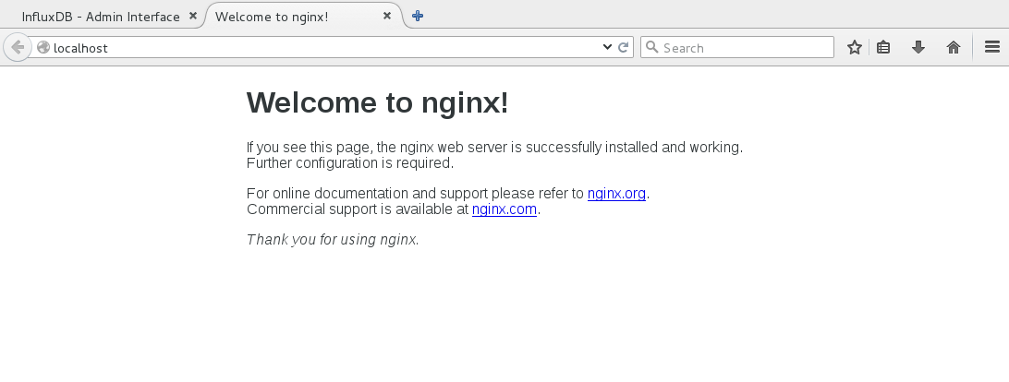
1. docker
1. dockerfile로 이미지 실행
[root@salt-master example]# docker images
REPOSITORY TAG IMAGE ID CREATED VIRTUAL SIZE
hello 0.1 3ce79615a316 5 minutes ago 227.7 MB
docker.io/ubuntu 14.04 ab035c88d533 5 days ago 187.9 MB
docker.io/ubuntu latest ab035c88d533 5 days ago 187.9 MB
[root@salt-master example]# docker run --name hello-nginx -d -p 80:80 -v /root/data:/data hello:0.1
a765784acfb9e4ff1ceef3af6f1e320b74ba613669a863d3cd2b744a9d43a767
[root@salt-master data]# docker ps
CONTAINER ID IMAGE COMMAND CREATED STATUS PORTS NAMES
a765784acfb9 hello:0.1 "nginx" 34 seconds ago Up 32 seconds 0.0.0.0:80->80/tcp, 443/tcp hello-nginx

Slide 34
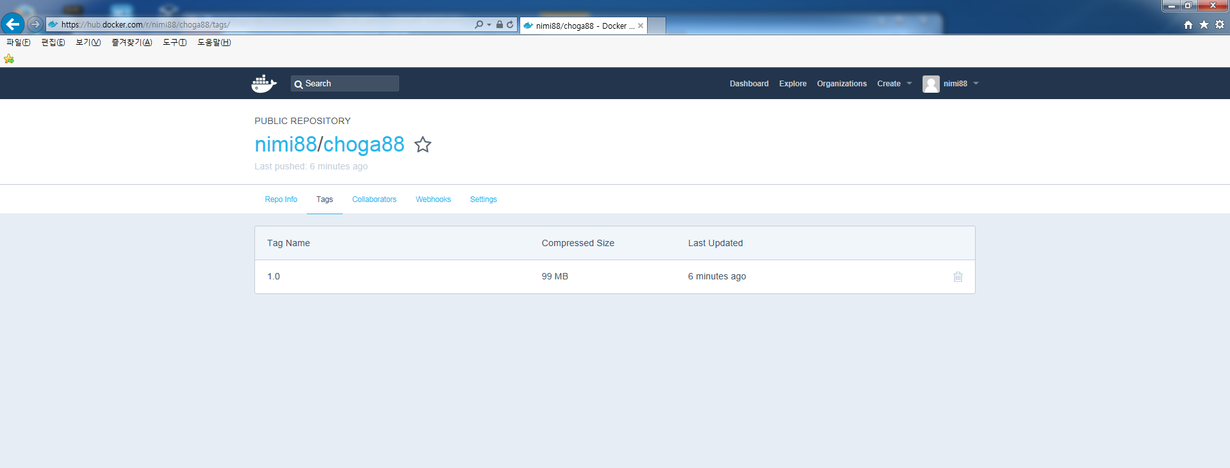
1. docker Hub
docker hub 사용
ㅇ도커 이미지 업로드
가. 로컬 repo는 도커허브 repo와 같은 name과 tag를 사용해야함
나. docker tag [image id] [repo:tag]로 이미 rename 또는
다. docker tag [local repo:tag] [Docker Hub repo:tag] rename 필요
[절차]
ㅇ hub.docker.com접속 (nimi88 / password접속)
ㅇ public/private repository 생성 (nimi88/choga88) -> 계정/reponame
ㅇ docker login
username: nimi88
password:
ㅇ docker tag imageid nimi88/choga88:1.0 → 계정/reponame:tag로 image를 수정
ㅇ docker push nimi88/choga88:1.0

Slide 35
1. docker볼륨
Docker Volumes
ㅇ도커 볼륨
가. docker 컨테이너의 life cycle과 독립하여 data를 보관하기 위한 지정된 디렉토리
나. docker 컨테이너가 죽더라도 data는 보존
다. 호스트의 디렉토리와 매핑되고 컨테이너간 공유될 수도 있음
라. 이미지 업데이트때 볼륨 변경사항은 포함되지 않음
마. 볼륨은 컨테이너가 생성되거나 실행되때 마운트됨
아. 볼륨경로는 절대경로를 지정해야함
※ Docker 데이터 볼륨은 데이터를 컨테이너가 아닌 호스트에 저장하는 방식
Docker 컨테이너 안의 파일 변경 사항은 Union File System에 의해 관리됩니다. 하지만 데이터 볼륨은
Union File System을 통하지 않고 바로 호스트에 저장됩니다. 따라서 docker commit 명령을 통해
이미지로 생성해도 데이터 볼륨의 변경 사항은 이미지에 포함되지 않습니다
[root@salt-master ~]# docker run –d –P –v /myvolume nginx
→ contrainer안에 /myvolume 디렉토리가 생성되고 호스트의 /var/lib/docker/volume에 매핑됨
[root@salt-master ~]# docker run –d -P -v /data:/web nginx
→ host의 /data/src디렉토리와 container의 /test/src 디렉토리를 매핑함
호스트와 컨테이너 디렉토리는 자동으로 생성됨
호스트 상위 디렉토리를 공유하면 하위디렉토리는 자동으로 포함됨

Slide 36
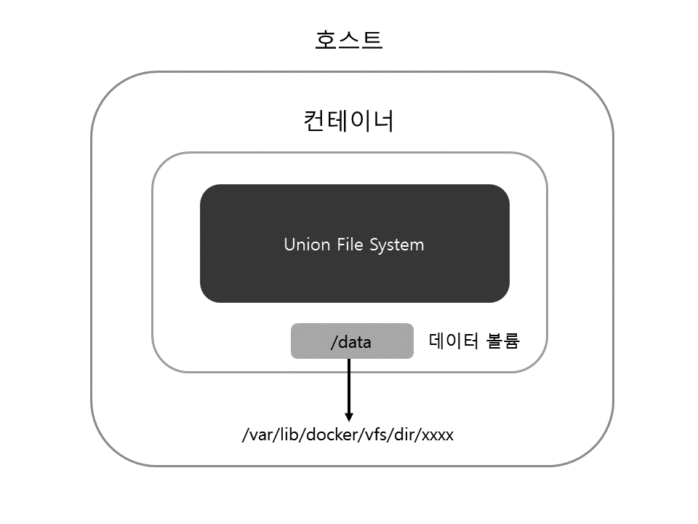
1. docker볼륨
Docker Volumes 실습1
# docker run -i -t --name vol -v /data ubuntu:14.04 /bin/bash
root@019265a6920f:/# cd /data
root@019265a6920f:/data# touch hello
root@019265a6920f:/data# exit
[root@q-nimi-os01 _data]# docker inspect vol | grep Source
"Source": "/var/lib/docker/volumes/b7a819393d834c4967a4ead826c0446463a2628dbf648f3c8478161bc31c6656/_data",
root@019265a6920f:/data# cd /var/lib/docker/volumes/b7a819393d834c4967a4ead826c0446463a2628dbf648f3c8478161bc31c6656/_data
[root@q-nimi-os01 _data]# ll
total 0
-rw-r--r-- 1 root root 0 May 29 21:27 hello

Slide 37
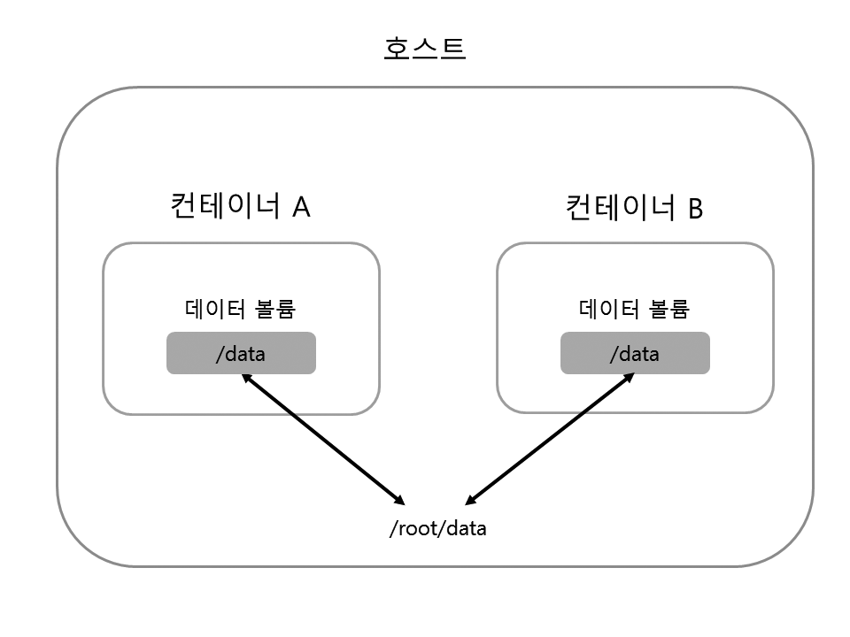
1. docker볼륨
Docker Volumes 실습2
#mkdir –p /root/data
#docker run -i -t --name vol1 -v /root/data:/data ubuntu:14.04 /bin/bash
root@f7baf3abefee:/# cd /data
root@f7baf3abefee:/data# touch world
root@f7baf3abefee:/data# exit
# ls /root/data
world
#docker run -i -t --name vol2 -v /root/data:/data ubuntu:14.04 /bin/bash
root@af5a7bdb3e5a:/# ls /data
world

Slide 38
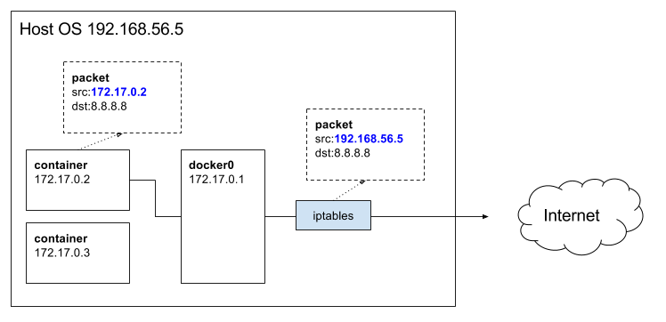
1. docker네트워크
Docker 네트워크
가. docker 컨테이너-> 브릿지(docker0)-> iptables-> 호스트 인터페이스-> 외부망
나. NAT라부르는 마스커레이드(Masquerade)를 iptables로 사용 (firewalld는 꺼져있어도됨)
다. PORT 매핑(포트포워딩)이 되있지 않으면 외부에서 접근이 안됨
라. 호스트 커널파라미터 net.ipv4.ip_forward = 1 로 설정
(net.ipv4.ip_forward = 1로 설정이 안된상태에서 PORT매핑시 ipv4 forward불가 메세지발생)
물리HOST
외부망

Slide 39
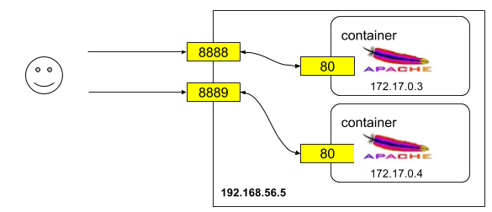
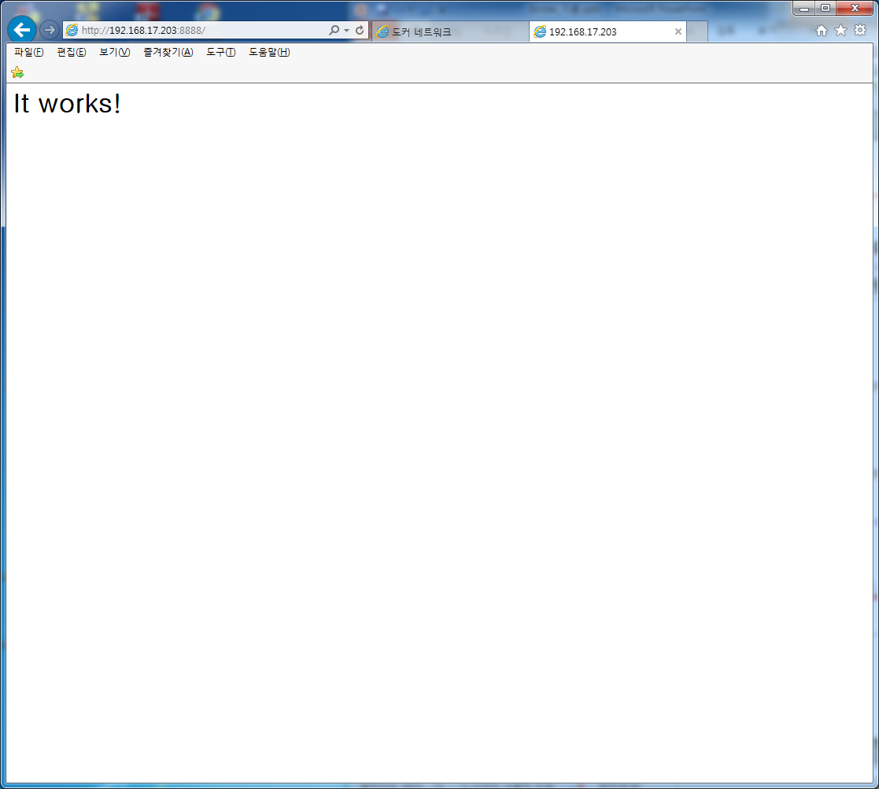
1. docker네트워크
Docker Port 매핑
가. docker 컨테이너 생성시 SNAT(MASQUERADE) iptables에 추가 (컨테이너->호스트방향)
나. PORT 매핑을 하면 DNAT iptable에 추가 (호스트->컨테이너 방향)
다. SNAT,DNAT가 모두 설정되야 정상으로 외부와 통신가능
[root@salt-master ~]# docker run --name web02 -d httpd
→ -p, -P 옵션이 없으므로 컨테이너는의 port가 호스트 port와 매핑되지 않음
[root@localhost ~]# iptables -t nat -L
Chain PREROUTING (policy ACCEPT)
target prot opt source destination
DOCKER all -- anywhere anywhere ADDRTYPE match dst-type LOCAL
Chain INPUT (policy ACCEPT)
target prot opt source destination
Chain OUTPUT (policy ACCEPT)
target prot opt source destination
DOCKER all -- anywhere !loopback/8 ADDRTYPE match dst-type LOCAL
Chain POSTROUTING (policy ACCEPT)
target prot opt source destination
MASQUERADE all -- 172.17.0.0/16 anywhere → 컨테이너에서 외부로 나가는 SNAT
Chain DOCKER (2 references)
target prot opt source destination
RETURN all -- anywhere anywhere
iptables -t nat -D PREROUTING -p tcp --dport 8888 -j DNAT --to-destination 172.17.0.2:80
→ iptables 수동으로 DNAT 추가후 웹페이지 정상동작 확인

Slide 40
1. docker네트워크
Docker Port 매핑
가. docker 컨테이너의 자신의 IPADDRESS를 가지지만 PORT는 호스트와 매핑됨
나. 호스트와 PORT매핑은 수동(-p 옵션) /자동(-P 옵션)으로 할 수 있음
다. 호스트의 iptables에 자동으로 SNAT, DNAT에 반영
[root@salt-master ~]# docker run –d –p 8080:80 nginx:1.0
→HOST의 8080->container의 80으로 매핑
[root@salt-master ~]# docker run –d –P nginx:1.0
자동으로 HOST의 49153~65535중 port-> container 의 EXPOSE 명령어로 노출된 port로 매핑
[root@q-chog-os02 ~]# iptables -t nat -L
Chain PREROUTING (policy ACCEPT)
target prot opt source destination
DOCKER all -- anywhere anywhere ADDRTYPE match dst-type LOCAL
Chain INPUT (policy ACCEPT)
target prot opt source destination
Chain OUTPUT (policy ACCEPT)
target prot opt source destination
DOCKER all -- anywhere !loopback/8 ADDRTYPE match dst-type LOCAL
Chain POSTROUTING (policy ACCEPT)
target prot opt source destination
MASQUERADE all -- 172.17.0.0/16 anywhere
MASQUERADE tcp -- 172.17.0.2 172.17.0.2 tcp dpt:http
Chain DOCKER (2 references)
target prot opt source destination
RETURN all -- anywhere anywhere
DNAT tcp -- anywhere anywhere tcp dpt:webcache to:172.17.0.2:80

Slide 41
1. docker네트워크
docker 컨테이너 네트워크
ㅇ도커 네트워크
가. bridge: 디폴트이며 호스트내의 컨테이너들을 bridge를 통하여 연결하며 외부통신은 iptable사용
나. none: loopback을 제외한 통신가능한 인터페이스가 없으므로 외부통신 불가
다. host: 호스트의 ip와 port를 공유하여 사용하므로 호스트와 컨테이너간 격리되지 않음
Driver | Description
Host | With the host driver, a container uses the networking stack of the host. There is no namespace separation, and all interfaces on the host can be used directly by the container
Bridge | The bridge driver creates a Linux bridge on the host that is managed by Docker. By default containers on a bridge can communicate with each other. External access to containers can also be configured through the bridge driver
Overlay | The overlay driver creates an overlay network that supports multi-host networks out of the box. It uses a combination of local Linux bridges and VXLAN to overlay container-to-container communications over physical network infrastructure
MACVLAN | The macvlan driver uses the MACVLAN bridge mode to establish a connection between container interfaces and a parent host interface (or sub-interfaces). It can be used to provide IP addresses to containers that are routable on the physical network. Additionally VLANs can be trunked to the macvlan driver to enforce Layer 2 container segmentation
None | The none driver gives a container its own networking stack and network namespace but does not configure interfaces inside the container. Without additional configuration, the container is completely isolated from the host networking stack
[docker run -it --name hello2 ubuntu /bin/bash
[root@glusterfs ~]# docker inspect hello2 | grep IPA
"IPAddress": "172.17.0.2",
"IPAddress": "172.17.0.2",
[root@glusterfs ~]# docker inspect -f "{{.NetworkSettings.IPAddress}}" hello2
172.17.0.2
[root@glusterfs ~]# docker exec hello2 ip a
16: eth0: <BROADCAST,MULTICAST,UP,LOWER_UP> mtu 1500 qdisc noqueue state UP group default
link/ether 02:42:ac:11:00:02 brd ff:ff:ff:ff:ff:ff
inet 172.17.0.2/16 scope global eth0
valid_lft forever preferred_lft forever
inet6 fe80::42:acff:fe11:2/64 scope link
[root@glusterfs ~]# docker exec -it hello2 /bin/bash/
root@8aadfb1607f5# ip a

Slide 42
1. docker네트워크
1. docker 네트워크 종류- bridge
[[root@localhost ~]# docker network ls
NETWORK ID NAME DRIVER SCOPE
13fbab22147e bridge bridge local -→ default
d6c43e76a69c host host local
e8e9d0b64668 none null local
[root@localhost ~]# docker network inspect bridge
[
{
"Name": "bridge",
"Id": "13fbab22147ea305d10d1790cf460f7291999b6561258c5a41af04a24a2d94f7",
"Scope": "local",
"Driver": "bridge",
"EnableIPv6": false,
"IPAM": {
"Driver": "default",
"Options": null,
"Config": [
{
"Subnet": "172.17.0.0/16"
}
]
},
"Internal": false,
"Containers": {
"d73517228d37ff30facb9bb738cb0f1df6b538cac5f02909b6ef3f6e7d9f0a3f": {
"Name": "hello",
"EndpointID": "4d45e603722f2fa9a921d5c44179fab8bf5ab70920facacb686690269e7b8cc5",
"MacAddress": "02:42:ac:11:00:02",
"IPv4Address": "172.17.0.2/16",
"IPv6Address": ""
}
},
"Options": {
"com.docker.network.bridge.default_bridge": "true",
"com.docker.network.bridge.enable_icc": "true",
"com.docker.network.bridge.enable_ip_masquerade": "true",
"com.docker.network.bridge.host_binding_ipv4": "0.0.0.0",
"com.docker.network.bridge.name": "docker0",
"com.docker.network.driver.mtu": "1500"
},
"Labels": {}
}
]

Slide 43
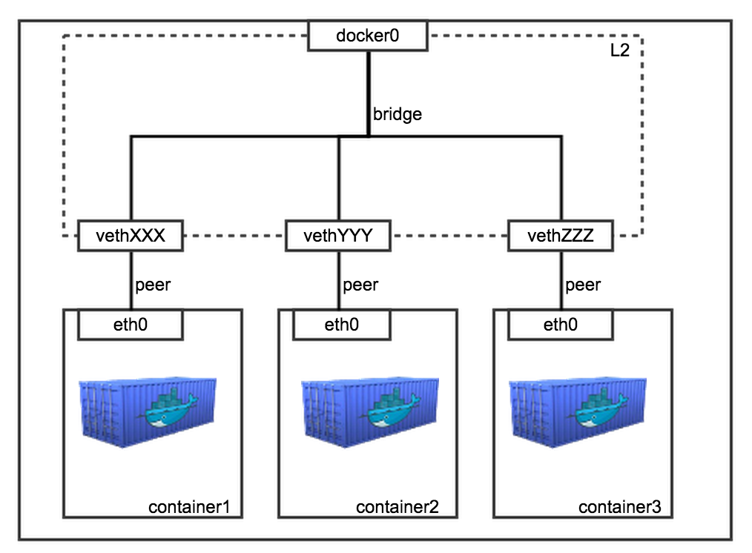
1. docker
docker 네트워크 종류- bridge
가. docker0이라는 리눅스 브리지에 컨테이너가 veth인터페이스로 연결됨(brctl show)
나. 케이블간 연결은 veth@if숫자~eth0@if숫자+1로 연결됨
다. 컨테이너 네트워크는 container id로 된 namespace에 생성
[root@salt-master example]# yum install bridge-utils
[root@salt-master example]# ip a
5: docker0: <BROADCAST,MULTICAST,UP,LOWER_UP> mtu 1500 qdisc noqueue state UP
link/ether 02:42:b9:53:56:de brd ff:ff:ff:ff:ff:ff
inet 172.17.42.1/16 scope global docker0
valid_lft forever preferred_lft forever
inet6 fe80::42:b9ff:fe53:56de/64 scope link
valid_lft forever preferred_lft forever
22: vethc4912da@if21: <BROADCAST,MULTICAST,UP,LOWER_UP> mtu 1500 qdisc noqueue master docker0 state UP
link/ether ca:06:d9:21:26:a9 brd ff:ff:ff:ff:ff:ff link-netnsid 0
inet6 fe80::c806:d9ff:fe21:26a9/64 scope link
valid_lft forever preferred_lft forever
26: veth3313fdc@if25: <BROADCAST,MULTICAST,UP,LOWER_UP> mtu 1500 qdisc noqueue master docker0 state UP
link/ether d2:53:c0:e3:32:c9 brd ff:ff:ff:ff:ff:ff link-netnsid 1
inet6 fe80::d053:c0ff:fee3:32c9/64 scope link
valid_lft forever preferred_lft forever
[root@salt-master example]# brctl show
bridge name bridge id STP enabled interfaces
docker0 8000.0242b95356de no veth3313fdc
vethc4912da
[root@salt-master example]# docker ps
CONTAINER ID IMAGE COMMAND CREATED STATUS PORTS NAMES
2862277c0cfc nginx "nginx -g 'daemon off" 10 minutes ago Up 10 minutes 443/tcp, 0.0.0.0:80->80/tcp web1
4012d1bdfce7 mongo "/entrypoint.sh mongo" 18 minutes ago Up 18 minutes
[root@salt-master example]# docker exec 2862277c0cfc ip r
default via 172.17.42.1 dev eth0
172.17.0.0/16 dev eth0 proto kernel scope link src 172.17.0.10
[root@salt-master example]# docker exec 4012d1bdfce7 ip r
default via 172.17.42.1 dev eth0
172.17.0.0/16 dev eth0 proto kernel scope link src 172.17.0.8

Slide 44
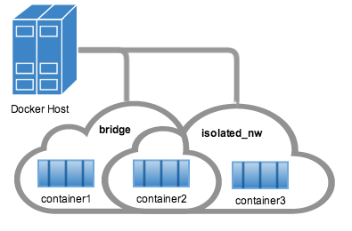
1. docker네트워크
1. docker 네트워크 종류- user define bridge
# docker network create --driver bridge isolated_nw
[root@localhost ~]# docker network ls
NETWORK ID NAME DRIVER SCOPE
b20d62c85950 bridge bridge local
f5805744dc61 host host local
6397e1cf3683 isolated_nw bridge local
b206c0ee9a81 none null local
#docker run -itd --name=container2 -P httpd
#docker network connect isolated_nw 0eaa5aae0205
[root@localhost ~]# brctl show
bridge name bridge id STP enabled interfaces
br-6397e1cf3683 8000.0242d5dad3d1 no vethb225b10
vethba5ec09
br-dc556d6f1b18 8000.0242c5800c88 no veth98184eb
docker0 8000.0242b1200ae6 no vethf056d8a
[root@localhost ~]# docker exec -it 0eaa5aae0205 bash
root@0eaa5aae0205:/usr/local/apache2# ip a
1: lo: <LOOPBACK,UP,LOWER_UP> mtu 65536 qdisc noqueue state UNKNOWN group default qlen 1
link/loopback 00:00:00:00:00:00 brd 00:00:00:00:00:00
inet 127.0.0.1/8 scope host lo
valid_lft forever preferred_lft forever
inet6 ::1/128 scope host
valid_lft forever preferred_lft forever
75: eth0@if76: <BROADCAST,MULTICAST,UP,LOWER_UP> mtu 1500 qdisc noqueue state UP group default
link/ether 02:42:ac:11:00:02 brd ff:ff:ff:ff:ff:ff
inet 172.17.0.2/16 scope global eth0
valid_lft forever preferred_lft forever
inet6 fe80::42:acff:fe11:2/64 scope link
valid_lft forever preferred_lft forever
77: eth1@if78: <BROADCAST,MULTICAST,UP,LOWER_UP> mtu 1500 qdisc noqueue state UP group default
link/ether 02:42:ac:12:00:04 brd ff:ff:ff:ff:ff:ff
inet 172.18.0.4/16 scope global eth1
valid_lft forever preferred_lft forever
inet6 fe80::42:acff:fe12:4/64 scope link
valid_lft forever preferred_lft forever
root@0eaa5aae0205:/usr/local/apache2# cat /etc/resolv.conf
search localdomain
nameserver 127.0.0.11
options ndots:0

Slide 45
1. docker네트워크
1. docker 네트워크 종류-host
[root@localhost ~]# docker run -d –P --net=host --name web02 httpd
[root@localhost ~]# docker exec web02 ip a ( host에서 ip a정보와 동일함)
1: lo: <LOOPBACK,UP,LOWER_UP> mtu 65536 qdisc noqueue state UNKNOWN group default qlen 1
link/loopback 00:00:00:00:00:00 brd 00:00:00:00:00:00
inet 127.0.0.1/8 scope host lo
valid_lft forever preferred_lft forever
inet6 ::1/128 scope host
valid_lft forever preferred_lft forever
2: ens33: <BROADCAST,MULTICAST,UP,LOWER_UP> mtu 1500 qdisc pfifo_fast state UP group default qlen 1000
link/ether 00:0c:29:40:e4:03 brd ff:ff:ff:ff:ff:ff
inet 192.168.17.196/24 brd 192.168.17.255 scope global dynamic ens33
valid_lft 1254sec preferred_lft 1254sec
inet6 fe80::20c:29ff:fe40:e403/64 scope link
valid_lft forever preferred_lft forever
3: docker0: <NO-CARRIER,BROADCAST,MULTICAST,UP> mtu 1500 qdisc noqueue state DOWN group default
link/ether 02:42:9a:96:91:ca brd ff:ff:ff:ff:ff:ff
inet 172.17.0.1/16 scope global docker0
valid_lft forever preferred_lft forever
inet6 fe80::42:9aff:fe96:91ca/64 scope link
valid_lft forever preferred_lft forever
[root@localhost ~]# brctl show
bridge name bridge id STP enabled interfaces
docker0 8000.02429a9691ca no
[root@localhost ~]# docker network inspect host
[
{
"Name": "host",
"Id": "d6c43e76a69cde32f91e55af65883e90fc5173860e3ac2d0009aa3be3945cef4",
"Scope": "local",
"Driver": "host",
"EnableIPv6": false,
"IPAM": {
"Driver": "default",
"Options": null,
"Config": []
},
"Internal": false,
"Containers": {
"60cf5176f9548e285f50e5fcb6646a5628d888e684e0f744ef5826d963385f7f": {
"Name": "web02",
"EndpointID": "8006d0ed72805ec8b2965eaaaf86fd5969bbbb8e620148b5833b14e4eef2a347",
"MacAddress": "",
"IPv4Address": "",
"IPv6Address": ""
}
},
"Options": {},
"Labels": {}
}
]

Slide 46
1. docker네트워크
1. docker 네트워크 종류-none(외부통신불가)
[root@localhost ~]# docker run --name web04 --net=none -d httpd
058983917da0887e2dbbe5b592d31f17a6a4bbd86fc2db0767450578a502ca5a
[root@localhost ~]# docker exec web04 ip a (인터페이스 자체가 생성되지 않음)
1: lo: <LOOPBACK,UP,LOWER_UP> mtu 65536 qdisc noqueue state UNKNOWN group default qlen 1
link/loopback 00:00:00:00:00:00 brd 00:00:00:00:00:00
inet 127.0.0.1/8 scope host lo
valid_lft forever preferred_lft forever
inet6 ::1/128 scope host
valid_lft forever preferred_lft forever
[root@localhost ~]#

Slide 47
1. docker네트워크
1. docker proxy
ㅇ docker host로 들어온 요청을 container로 넘기는 역할 (host의 iptables가 disable인 경우만 동작)
ㅇ kernel이 아닌 userland에서 수행되며 host가 받은 패킷을 container의 port로 전달
ㅇ docker-proxy는 port를 노출하는 수만큼 프로세스가 생성됨
ㅇ host의 iptables에 enable인 경우는 iptables에 의하여 동작
[root@localhost system]# docker ps
CONTAINER ID IMAGE COMMAND CREATED STATUS PORTS NAMES
ca645c7f37fe httpd "httpd-foreground" About an hour ago Up 4 minutes 0.0.0.0:32770->80/tcp web12
[root@localhost system]# netstat -nlp | grep 32770
tcp6 0 0 :::32770 :::* LISTEN 38764/docker-proxy-
[root@localhost system]# iptables -t nat –F → nat 테이블 초기화
[root@localhost system]# iptables -t nat –L
Chain PREROUTING (policy ACCEPT)
target prot opt source destination
Chain INPUT (policy ACCEPT)
target prot opt source destination
Chain OUTPUT (policy ACCEPT)
target prot opt source destination
Chain POSTROUTING (policy ACCEPT)
target prot opt source destination
Chain DOCKER (0 references)
target prot opt source destination
Chain DOCKER (0 references)
target prot opt source destination
[root@localhost system]# ps -ef | grep proxy
root 37933 1 0 03:58 ? 00:00:00 /usr/bin/dockerd-current --add-runtime docker-runc=/usr/libexec/docker/docker-runc-current --default-runtime=docker-runc --exec-opt native.cgroupdriver=systemd --userland-proxy-path=/usr/libexec/docker/docker-proxy-current --selinux-enabled --log-driver=journald --signature-verification=false
root 38764 37933 0 04:09 ? 00:00:00 /usr/libexec/docker/docker-proxy-current -proto tcp -host-ip 0.0.0.0 -host-port 32770 -container-ip 172.17.0.2 -container-port 80
[root@localhost system]# kill -9 38764 → docker-proxy process kill 이후에는 웹페이지 접속안됨

Slide 48
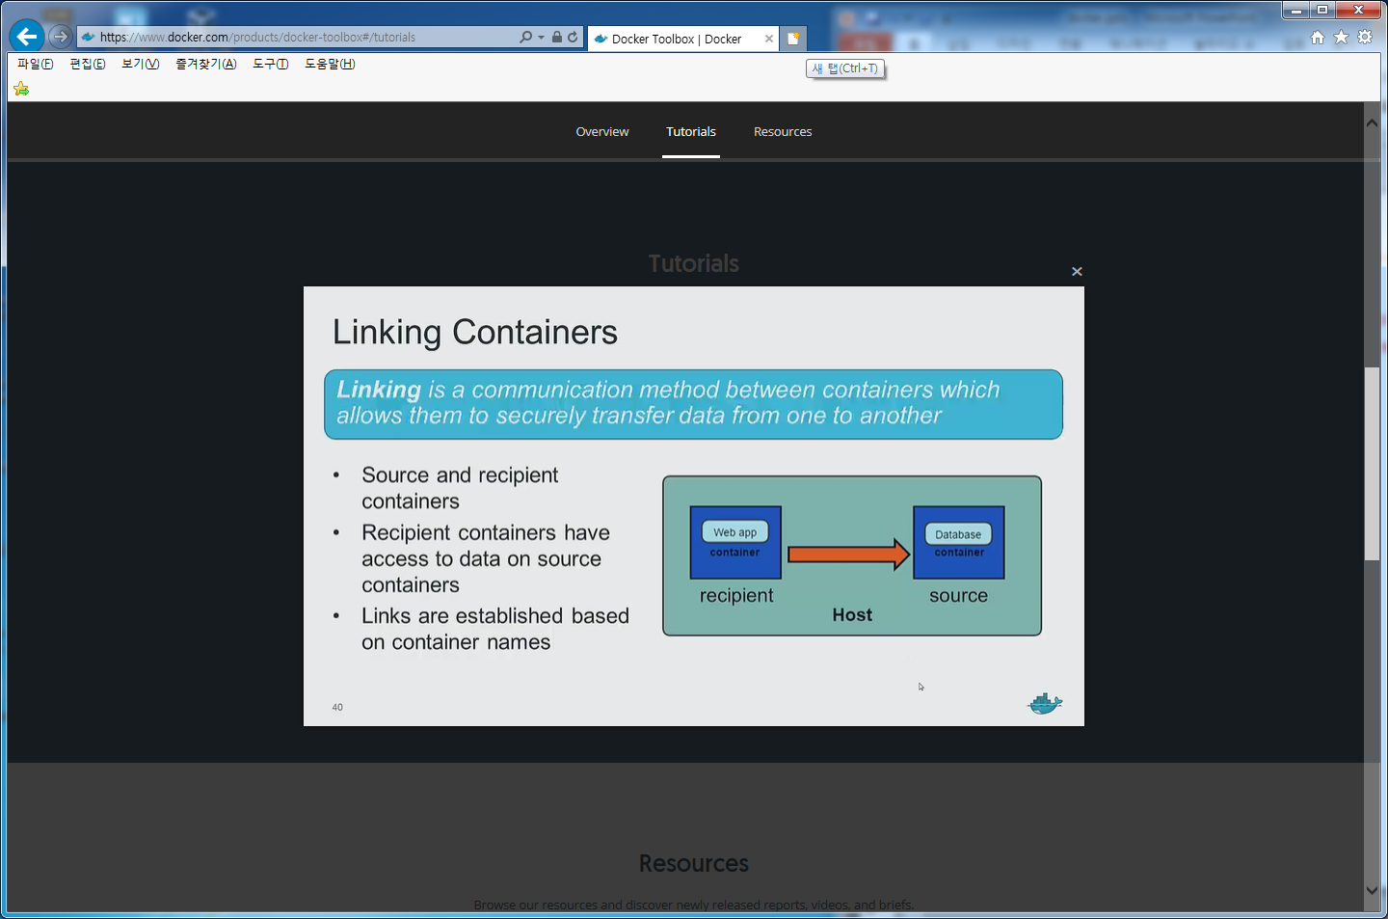
1. docker
1. docker 컨테이너간 연결
ㅇ 호스트의 포트 expose없이 컨테이너간 통신가능
ㅇ 다른 호스트에 존재하는 컨테이너 사이에는 link 옵션이 불가능하다.
ㅇ LINK 연동이 설정된 컨테이너의(recipient) /etc/hosts파일에 연결할 컨테이너가(source) 등록됨
ㅇ micro service application architecure에서 필수적(tomcat->mysql)
[root@salt-master ~]# docker run –d --name dbms postgres → source 컨테이너를 먼저 실행시킨다.
[root@salt-master ~]# docker run –d –P --name website --link dbms:db nginx → recipient 컨테이너에 –link source 컨테이너이름: alis 설정
[root@salt-master ~]# docker inspect dbms | grep IPAddress → website 컨테이너의 /etc/hosts의 IP와 일치

Slide 49
1. docker
1. docker 컨테이너간 연결
[root@salt-master data]# docker run --name db -d mongo
Unable to find image 'mongo:latest' locally
Trying to pull repository docker.io/library/mongo ... latest: Pulling from library/mongo
002a4599f1ba: Pull complete
43d31a5a4c8c: Pull complete
Status: Downloaded newer image for docker.io/mongo:latest
4012d1bdfce7e36922ea74fe118e17d79e50b563a29452fa5b01d7c11bf2bacf
[root@salt-master data]# docker ps
CONTAINER ID IMAGE COMMAND CREATED STATUS PORTS NAMES
4012d1bdfce7 mongo "/entrypoint.sh mongo" 8 seconds ago Up 7 seconds 27017/tcp db
[root@salt-master data]# docker run --name web -d -p 80:80 --link db:db nginx
Unable to find image 'nginx:latest' locally
Trying to pull repository docker.io/library/nginx ... latest: Pulling from library/nginx
d8bd0657b25f: Pull complete
a582cd499e0f: Pull complete
Digest: sha256:f6a001272d5d324c4c9f3f183e1b69e9e0ff12debeb7a092730d638c33e0de3e
Status: Downloaded newer image for docker.io/nginx:latest
bf3f362eac0ed5064d6ed579cc758b28f40ddd292f36f89e113f76297a759a3e
[root@salt-master data]# docker ps
CONTAINER ID IMAGE COMMAND CREATED STATUS PORTS NAMES
bf3f362eac0e nginx "nginx -g 'daemon off" 12 seconds ago Up 11 seconds 0.0.0.0:80->80/tcp, 443/tcp web
4012d1bdfce7 mongo "/entrypoint.sh mongo" About a minute ago Up About a minute 27017/tcp db
[root@salt-master data]# docker exec -it bf3f362eac0e /bin/bash
root@2862277c0cfc:/#
web 컨테이너안에서 db:27017 주소로 db 컨테이너의 MongoDB에 접속할 수 있습니다.
mongodb://db:27017/exampledb
root@5d4adea2060a:/# cat /etc/hosts
127.0.0.1 localhost
::1 localhost ip6-localhost ip6-loopback
fe00::0 ip6-localnet
ff00::0 ip6-mcastprefix
ff02::1 ip6-allnodes
ff02::2 ip6-allrouters
172.17.0.8 db cdda10943e88
172.17.0.2 5d4adea2060a

Slide 50
1. docker
docker 이미지 History
[root@salt-master data]# docker history hello:0.1 (이미지의 변경사항 확인)
IMAGE CREATED CREATED BY SIZE COMMENT
3ce79615a316 12 minutes ago /bin/sh -c #(nop) EXPOSE 443/tcp 0 B
088d274280c6 12 minutes ago /bin/sh -c #(nop) EXPOSE 80/tcp 0 B
4a7811526535 12 minutes ago /bin/sh -c #(nop) CMD ["nginx"] 0 B
2daa3ae20593 12 minutes ago /bin/sh -c #(nop) WORKDIR /etc/nginx 0 B
1c0217d0b326 12 minutes ago /bin/sh -c #(nop) VOLUME [/data /etc/nginx/si 0 B
8743db1b1f01 12 minutes ago /bin/sh -c chown -R www-data:www-data /var/li 0 B
4b08b098e12f 12 minutes ago /bin/sh -c echo "\ndaemon off;" >> /etc/nginx 1.614 kB
45985833a796 12 minutes ago /bin/sh -c apt-get install -y nginx 18.14 MB
87dcea40f45d 13 minutes ago /bin/sh -c apt-get update 21.61 MB
6f3ee8aeb91f 15 minutes ago /bin/sh -c #(nop) MAINTAINER Foo Bar <foo@bar 0 B
2. docker 컨테이너 파일복사
[root@salt-master data]# docker cp hello-nginx:/etc/nginx/nginx.conf .
[root@salt-master data]# ll
total 4
-rw-r--r--. 1 root root 0 Mar 24 05:20 a
-rw-r--r--. 1 root root 1614 Mar 24 05:10 nginx.conf
[root@salt-master data]# cat nginx.conf
user www-data;
worker_processes 4;
pid /run/nginx.pid;
events {

Slide 51
1. docker
docker diff
ㅇdiff는 컨테이너가 생성된 이미지와 실행중인 컨테이너간 변경사항을 diff로 표기
ㅇA는 추가된 파일, C는 변경된 파일, D는 삭제된 파일
[root@salt-master data]# docker diff hello-nginx
C /etc
C /etc/nginx
A /etc/nginx/site-enabled
C /run
C /run/secrets
A /run/nginx.pid
C /var
C /var/lib
C /var/lib/nginx
A /var/lib/nginx/uwsgi
A /var/lib/nginx/body
A /var/lib/nginx/fastcgi
A /var/lib/nginx/proxy
A /var/lib/nginx/scgi
A /data

Slide 52
1. docker
1. docker 로그 및 트러블 슈팅
1. docker build 문제발생시
Step 4 : RUN echo "daemon off;" >> /etc/nginx/nginx.conf
---> Running in d8561b6b3aba
---> 353936cec1c9
Removing intermediate container d8561b6b3aba
Step 5 : RUN mkdir /etc/nginx/ssl
---> Running in 83605fb08c75
---> 518ef7bd1d09
Removing intermediate container 83605fb08c75
Step 6 : ADD default /etc/nginx/sites-available/default
---> 9940a0310f0f
Removing intermediate container 91f2953f2888
Step 7 : EXPOSE 80
---> Running in adf44898995d
---> 1e17fa0b8e83
Removing intermediate container adf44898995d
Step 8 : CMD nginx
---> Running in 24892467a899
---> da6aac6f5de6
Removing intermediate container 24892467a899
Successfully built da6aac6f5de6
[root@salt-master nginx]# docker run -it 353936cec1c9 /bin/bash -> 특정단계에서 실패했을때 이미지에 접속하여 트러블 슈팅
[root@salt-master Desktop]# docker logs -f -t ff8e3dcd8b59 -> 로그를 볼때
2016-03-26T08:46:21.663743573Z AH00558: apache2: Could not reliably determine the server's fully qualified domain name, using 172.17.0.46. Set the 'ServerName' directive globally to suppress this message
[root@salt-master Desktop]# docker logs -f -t 3d2f5501f515
2016-03-26T08:45:48.480663168Z 160326 8:45:48 [Warning] Using unique option prefix key_buffer instead of key_buffer_size is deprecated and will be removed in a future release. Please use the full name instead.
2016-03-26T08:45:48.480708661Z 160326 8:45:48 [Note] mysqld (mysqld 5.5.47-0ubuntu0.14.04.1) starting as process 40 ...
2016-03-26T08:45:50.609809821Z 160326 8:45:50 [Warning] Using unique option prefix key_buffer instead of key_buffer_size is deprecated and will be removed in a future release. Please use the full name instead.
2016-03-26T08:45:50.620707081Z 160326 8:45:50 [Note] mysqld (mysqld 5.5.47-0ubuntu0.14.04.1) starting as process 60 ...
2. docker store state 문제발생시 (error 메세지 참고)
/usr/bin/docker-current: Error response from daemon: updating the store state of sandbox failed: failed to update store for object type *li bnetwork.sbState: json: cannot unmarshal object into Go struct field sbState.ExtDNS of type string
ㅇ rm -rf /var/lib/docker
ㅇ systemctl restart docker

Slide 53
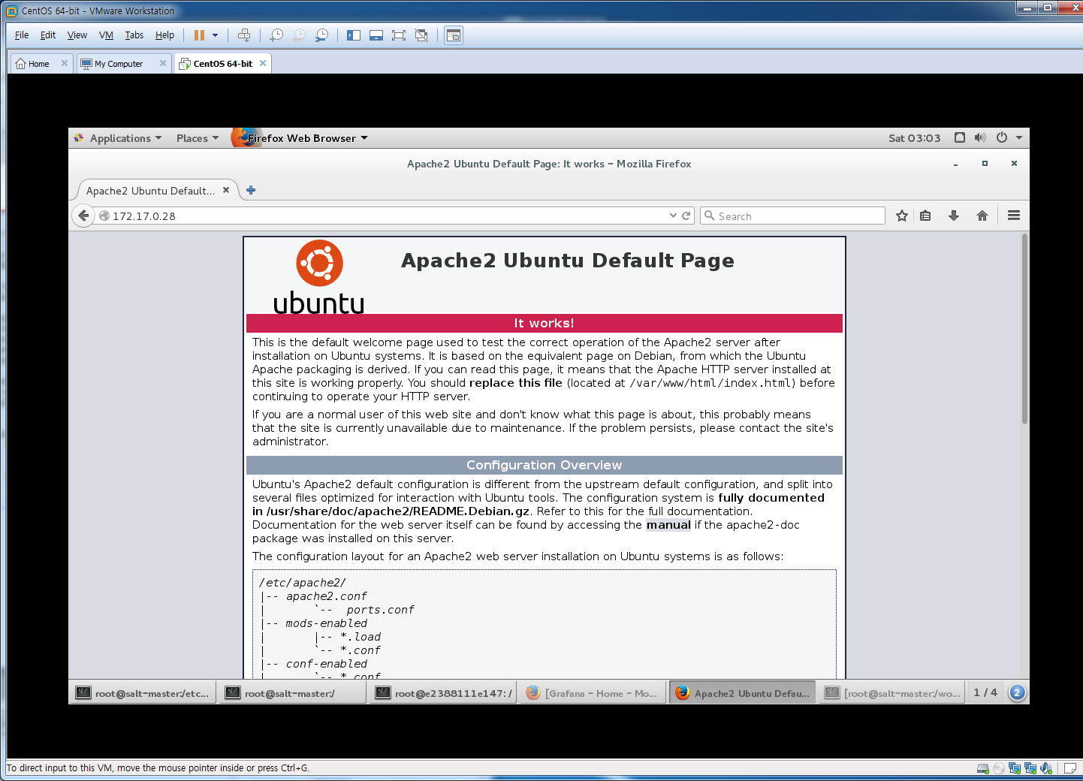
1. docker [활용법1]
1. docker 아파치설치 (컨테이너에 apache설치)
[root@salt-master home]# docker run -it -d -p 80:80 --name web1 ubuntu:latest /bin/bash
e2388111e147c5b0ee06a4022cb3e32c4143f50f38e58259d36f3af26d9fa19e
root@salt-master home]# apt-get update
root@e2388111e147:/#
root@e2388111e147:/# apt-get install apache2
Reading package lists... Done
Building dependency tree
Reading state information... Done
The following extra packages will be installed:
root@e2388111e147:/# service apache2 start
* Restarting web server apache2
AH00558: apache2: Could not reliably determine the server's fully qualified domain name, using 172.17.0.28. Set the 'ServerName' directive globally to suppress this message
[ OK ]
root@e2388111e147:/# ps -ef | grep apache
root 867 1 0 06:58 ? 00:00:00 /usr/sbin/apache2 -k start
www-data 869 867 0 06:58 ? 00:00:00 /usr/sbin/apache2 -k start
www-data 870 867 0 06:58 ? 00:00:00 /usr/sbin/apache2 -k start
root 931 1 0 06:58 ? 00:00:00 grep --color=auto apache
[root@salt-master workspace]# ps -ef | grep docker
root 15210 1 0 Mar25 ? 00:01:59 /usr/bin/docker daemon --selinux-enabled
root 34540 15210 0 02:52 ? 00:00:00 docker-proxy -proto tcp -host-ip 0.0.0.0 -host-port 80 -container-ip 172.17.0.28 -container-port 80
root 34597 10402 0 02:52 pts/1 00:00:00 docker attach web1
root 35741 26084 0 03:05 pts/6 00:00:00 grep --color=auto docker

Slide 54
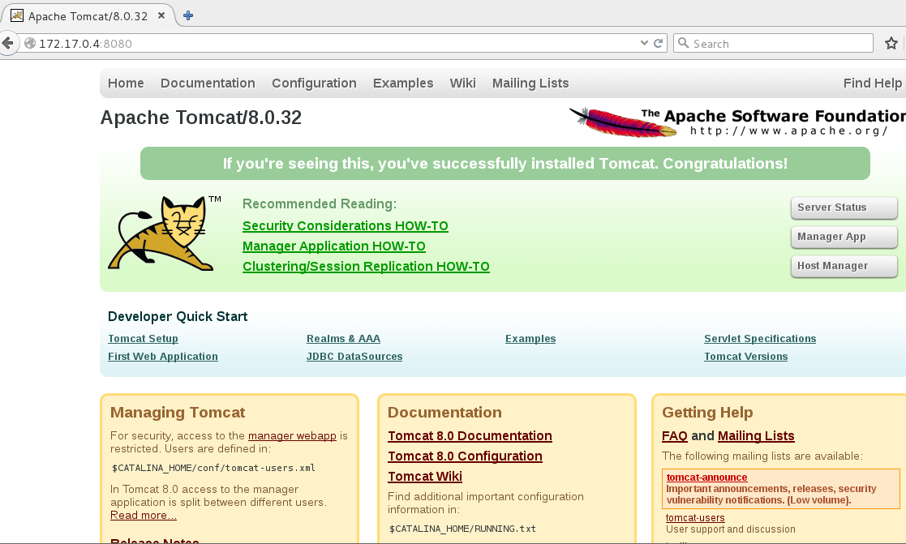
1. docker [활용법2]
1. docker 톰캣설치 (톰캣 실행된 이미지까지 다운 받아 컨테이너 동작)
[root@salt-master Desktop]# docker run -it -d -p 8080:8080 tomcat:8.0
fd2d6ca1fb9e9c2e13694a7c590221b695859d9a83c4a98ffdcfeb22ecb6c3c5
[root@salt-master Desktop]# docker exec -it fd2d6ca1fb9e /bin/bash
root@fd2d6ca1fb9e:/usr/local/tomcat# ps -ef | grep tomcat
root 1 0 2 01:49 ? 00:00:04 /usr/lib/jvm/java-7-openjdk-amd64/jre/bin/java -Djava.util.logging.config.file=/usr/local/tomcat/conf/logging.properties -Djava.util.logging.manager=org.apache.juli.ClassLoaderLogManager -Djava.endorsed.dirs=/usr/local/tomcat/endorsed -classpath /usr/local/tomcat/bin/bootstrap.jar:/usr/local/tomcat/bin/tomcat-juli.jar -Dcatalina.base=/usr/local/tomcat -Dcatalina.home=/usr/local/tomcat -Djava.io.tmpdir=/usr/local/tomcat/temp org.apache.catalina.startup.Bootstrap start
root 48 43 0 01:52 ? 00:00:00 grep tomcat
[root@salt-master workspace]# ps -ef | grep docker
root 15210 1 0 Mar25 ? 00:01:59 /usr/bin/docker daemon --selinux-enabled
root 34540 15210 0 02:52 ? 00:00:00 docker-proxy -proto tcp -host-ip 0.0.0.0 -host-port 8080 -container-ip 172.17.0.3 -container-port 8080
root 34597 10402 0 02:52 pts/1 00:00:00 docker attach web1
root 35741 26084 0 03:05 pts/6 00:00:00 grep --color=auto docker
root@fd2d6ca1fb9e:/usr/local/tomcat# ip a
1: lo: <LOOPBACK,UP,LOWER_UP> mtu 65536 qdisc noqueue state UNKNOWN group default
link/loopback 00:00:00:00:00:00 brd 00:00:00:00:00:00
inet 127.0.0.1/8 scope host lo
valid_lft forever preferred_lft forever
inet6 ::1/128 scope host
valid_lft forever preferred_lft forever
13: eth0@if14: <BROADCAST,MULTICAST,UP,LOWER_UP> mtu 1500 qdisc noqueue state UP group default
link/ether 02:42:ac:11:00:04 brd ff:ff:ff:ff:ff:ff
inet 172.17.0.4/16 scope global eth0
valid_lft forever preferred_lft forever
inet6 fe80::42:acff:fe11:4/64 scope link
valid_lft forever preferred_lft forever
root@fd2d6ca1fb9e:/usr/local/tomcat#

Slide 55
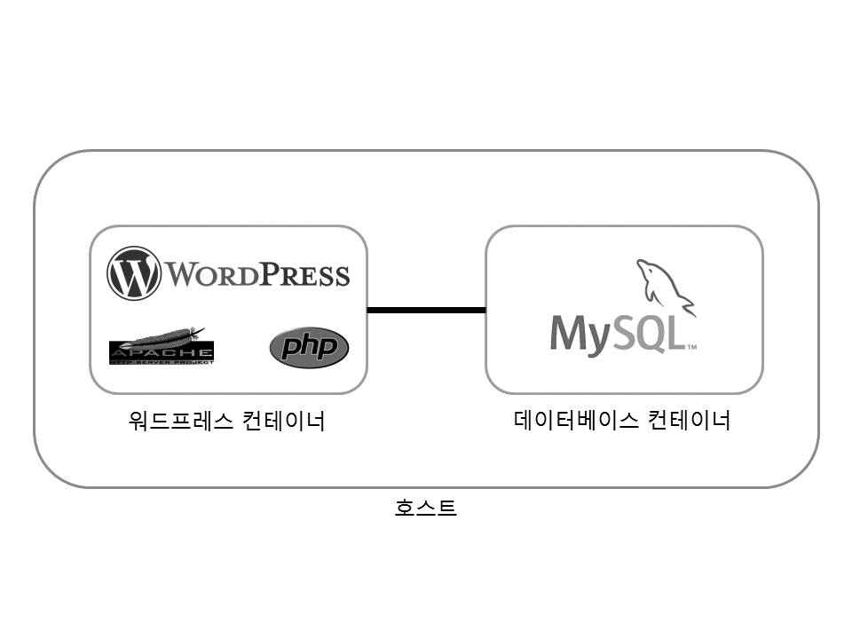
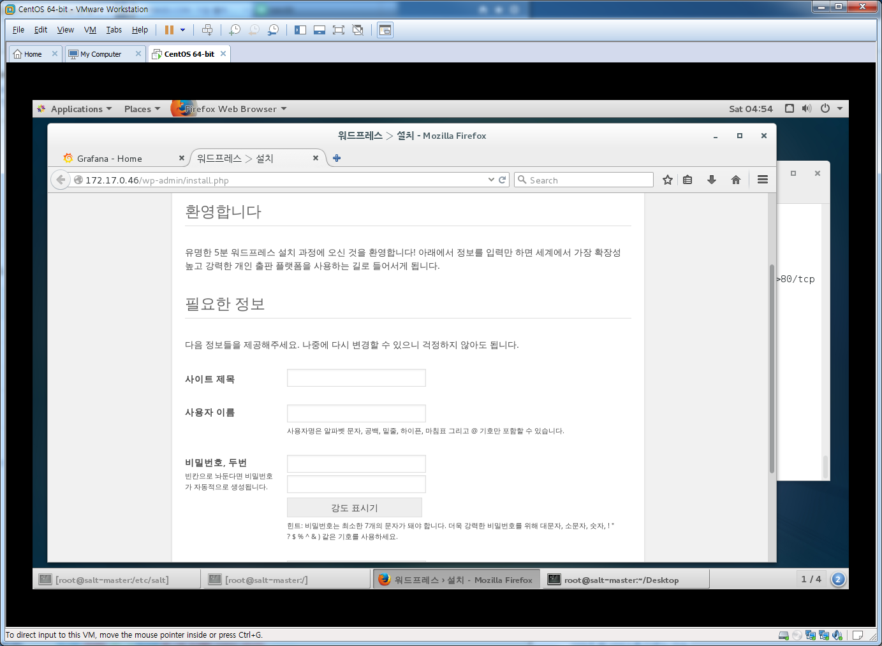
1. docker [활용법3]
1. docker 워드프로세스 블로그 구축
[root@salt-master example]#mkdir wordpress
[root@salt-master example]#cd wordpress
vi Dockerfile (https://github.com/pyrasis/dockerbook/tree/master/Chapter16 참조)
vi entrypoint.sh (https://github.com/pyrasis/dockerbook/tree/master/Chapter16 참조)
[root@salt-master example]#docker build –t wordpress
[root@salt-master example]#mkdir mysql
[root@salt-master example]#cd mysql
vi Dockerfile (https://github.com/pyrasis/dockerbook/tree/master/Chapter16 참조)
vi entrypoint.sh (https://github.com/pyrasis/dockerbook/tree/master/Chapter16 참조)
[root@salt-master example]#docker build –t mysql
[root@salt-master Desktop]# docker run -d --name db -e MYSQL_ROOT_PASSWORD=example mysql
3d2f5501f51559af3726a8f2c59bb2901a7613fc1d2407b13a99b658ca4c0881
[root@salt-master Desktop]# docker run -d --name example-wp -p 80:80 --link db:db wordpress
ff8e3dcd8b591d2b35a15a426b34c9d686e8f65248f2bd74a5d8e3c32554bb04
[root@salt-master Desktop]# docker ps
CONTAINER ID IMAGE COMMAND CREATED STATUS PORTS NAMES
ff8e3dcd8b59 wordpress "/bin/sh -c /entrypoi" About a minute ago Up About a minute 0.0.0.0:80->80/tcp example-wp
3d2f5501f515 mysql "/bin/sh -c /entrypoi" 2 minutes ago Up 2 minutes 3306/tcp db

Slide 56
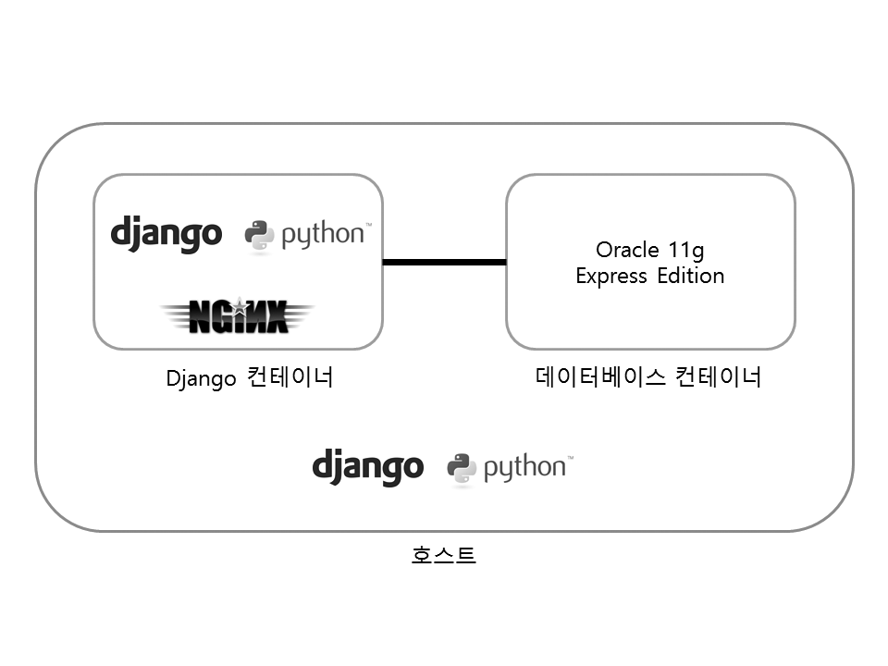
1. docker [활용법4]
1. docker django 프레임
[root@salt-master example]#yum install python-pip python-devel gcc
[root@salt-master example]#pip install django MySQL-python
[root@salt-master example]#django-admin.py startproject exampleapp
[root@salt-master exampleapp]# ll
total 4
drwxr-xr-x 2 root root 70 Mar 27 06:41 exampleapp
-rwxr-xr-x 1 root root 253 Mar 27 06:41 manage.py
[root@salt-master exampleapp]# cd exampleapp/
[root@salt-master exampleapp]# ll
total 12
-rw-r--r-- 1 root root 0 Mar 27 06:41 __init__.py
-rw-r--r-- 1 root root 3178 Mar 27 06:41 settings.py
-rw-r--r-- 1 root root 766 Mar 27 06:41 urls.py
-rw-r--r-- 1 root root 397 Mar 27 06:41 wsgi.py

Slide 57
1. docker compose란
docker compose
Compose는 multi-container Docker applications을 정의하고 동작시키는 tool
하나의 명령어로 환경설정으로 서비스를 구동할수 있다.
2. docker-compose 구성방법
가. Dockerfile 정의
나. docker-compose.yml 정의
다. docker-compose up
3. docker-compose.yml 파일구조(https://docs.docker.com/compose/compose-file참조)
version: '3‘ → compose 버젼정의
services: → 서비스 컨테이너 정의
web:
build: .
ports:
- "5000:5000"
volumes:
- .:/code
- logvolume01:/var/log
links:
- redis
redis:
image: redis
volumes:
logvolume01: {}

Slide 58
1. docker compose란
docker compose 명령어
[root@q-nimi-os01 ~]# docker-compose --help
Define and run multi-container applications with Docker.
Usage:
docker-compose [-f <arg>...] [options] [COMMAND] [ARGS...]
docker-compose -h|--help
Options:
-f, --file FILE Specify an alternate compose file (default: docker-compose.yml)
-p, --project-name NAME Specify an alternate project name (default: directory name)
--verbose Show more output
-v, --version Print version and exit
-H, --host HOST Daemon socket to connect to
--tls Use TLS; implied by --tlsverify
--tlscacert CA_PATH Trust certs signed only by this CA
--tlscert CLIENT_CERT_PATH Path to TLS certificate file
--tlskey TLS_KEY_PATH Path to TLS key file
--tlsverify Use TLS and verify the remote
--skip-hostname-check Don't check the daemon's hostname against the name specified
in the client certificate (for example if your docker host
is an IP address)
--project-directory PATH Specify an alternate working directory
(default: the path of the compose file)
Commands:
build Build or rebuild services
bundle Generate a Docker bundle from the Compose file
config Validate and view the compose file
create Create services
down Stop and remove containers, networks, images, and volumes
events Receive real time events from containers
exec Execute a command in a running container
help Get help on a command
images List images
kill Kill containers
logs View output from containers
pause Pause services
port Print the public port for a port binding
ps List containers
pull Pull service images
push Push service images
restart Restart services
rm Remove stopped containers
run Run a one-off command
scale Set number of containers for a service
start Start services
stop Stop services
top Display the running processes
unpause Unpause services
up Create and start containers
version Show the Docker-Compose version information

Slide 59
1. docker compose란
docker compose wordpress설치
yum install epel-release
yum install -y python-pip
pip install docker-compose
yum upgrade python*
mkdir my_wordpress && cd my_wordpress
vi docker-compose.yml
version: '2'
services:
db:
image: mysql:5.7
volumes:
- db_data:/var/lib/mysql
restart: always
environment:
MYSQL_ROOT_PASSWORD: somewordpress
MYSQL_DATABASE: wordpress
MYSQL_USER: wordpress
MYSQL_PASSWORD: wordpress
wordpress:
depends_on:
- db
image: wordpress:latest
ports:
- "8000:80"
restart: always
environment:
WORDPRESS_DB_HOST: db:3306
WORDPRESS_DB_USER: wordpress
WORDPRESS_DB_PASSWORD: wordpress
volumes:
db_data:
[root@q-nimi-os01 my_wordpress]# docker-compose up -d
WARNING: The Docker Engine you're using is running in swarm mode.
Compose does not use swarm mode to deploy services to multiple nodes in a swarm. All containers will be scheduled on the current node.
To deploy your application across the swarm, use `docker stack deploy`.
Creating network "mywordpress_default" with the default driver
Creating volume "mywordpress_db_data" with default driver
Pulling db (mysql:5.7)...
Trying to pull repository docker.io/library/mysql ...
5.7: Pulling from docker.io/library/mysql
10a267c67f42: Already exists
c2dcc7bb2a88: Pull complete
17e7a0445698: Pull complete
9a61839a176f: Pull complete
a1033d2f1825: Pull complete
0d6792140dcc: Pull complete
cd3adf03d6e6: Pull complete
d79d216fd92b: Pull complete
b3c25bdeb4f4: Pull complete
02556e8f331f: Pull complete
4bed508a9e77: Pull complete
Digest: sha256:2f4b1900c0ee53f344564db8d85733bd8d70b0a78cd00e6d92dc107224fc84a5
Pulling wordpress (wordpress:latest)...
Trying to pull repository docker.io/library/wordpress ...
latest: Pulling from docker.io/library/wordpress
10a267c67f42: Already exists
370377701f89: Pull complete
455c73a122bc: Pull complete
fb71bac61c47: Pull complete
288a1d91ad4e: Pull complete
86e0256ba4b0: Pull complete
f14fbe7a9dfb: Pull complete
0f36dd91c0ab: Pull complete
97d77fc1fd2c: Pull complete
d8c0a0fd7605: Pull complete
79601c211937: Pull complete
48bba15d4000: Pull complete
96a57b907249: Pull complete
24ed18a8e864: Pull complete
10174a4940d5: Pull complete
b9198f664ee8: Pull complete
b653a25ed3ad: Pull complete
6e8e148761ae: Pull complete
Digest: sha256:35ba258dd73b09ca87836fabab1e166dd87456abdb68a6d361d83200b8337b87
Creating mywordpress_db_1 ...
Creating mywordpress_db_1 ... done
Creating mywordpress_wordpress_1 ...
Creating mywordpress_wordpress_1 ... done
[root@q-nimi-os01 my_wordpress]# 웹브라우저에서 http://10.40.99.138:8000으로 접속

Slide 60
1. docker compose란
docker compose web 서비스 설치
mkdir composetest && cd composetest
vi app.py
from flask import Flask
from redis import Redis
app = Flask(__name__)
redis = Redis(host='redis', port=6379)
@app.route('/')
def hello():
count = redis.incr('hits')
return 'Hello World! I have been seen {} times.\n'.format(count)
if __name__ == "__main__":
app.run(host="0.0.0.0", debug=True)
vi requirements.txt
flask
redis
vi Dockerfile
FROM python:3.4-alpine
ADD . /code
WORKDIR /code
RUN pip install -r requirements.txt
CMD ["python", "app.py"]
vi docker-compose.yml
version: '2'
services:
web:
build: .
ports:
- "5000:5000"
volumes:
- .:/code
redis:
image: "redis:alpine"

Slide 61
1. docker compose란
docker compose 실행
[root@q-nimi-os01 composetest]# docker-compose up -d
Creating network "composetest_default" with the default driver
Building web
Step 1 : FROM python:3.4-alpine
Trying to pull repository docker.io/library/python ...
3.4-alpine: Pulling from docker.io/library/python
79650cf9cc01: Pull complete
581a2604819e: Pull complete
cbecf1ae8c88: Pull complete
61e46b909d80: Pull complete
bb7832cbe509: Pull complete
Digest: sha256:18dc69c99d5341142b93d7c961dd384c7ab2815106352bb2d9c0594df4d0a8d2
---> 8214d6de194b
Step 2 : ADD . /code
---> b0c4d3f29059
Removing intermediate container a3d7c9440ccb
Step 3 : WORKDIR /code
---> Running in d4b01cadec8b
---> 17451484c24a
Removing intermediate container d4b01cadec8b
Step 4 : RUN pip install -r requirements.txt
---> Running in 45ed5778d08c
Collecting flask (from -r requirements.txt (line 1))
Downloading Flask-0.12.2-py2.py3-none-any.whl (83kB)
Collecting redis (from -r requirements.txt (line 2))
Downloading redis-2.10.5-py2.py3-none-any.whl (60kB)
Collecting click>=2.0 (from flask->-r requirements.txt (line 1))
Downloading click-6.7-py2.py3-none-any.whl (71kB)
Collecting Werkzeug>=0.7 (from flask->-r requirements.txt (line 1))
Downloading Werkzeug-0.12.2-py2.py3-none-any.whl (312kB)
Collecting Jinja2>=2.4 (from flask->-r requirements.txt (line 1))
Downloading Jinja2-2.9.6-py2.py3-none-any.whl (340kB)
Collecting itsdangerous>=0.21 (from flask->-r requirements.txt (line 1))
Downloading itsdangerous-0.24.tar.gz (46kB)
Collecting MarkupSafe>=0.23 (from Jinja2>=2.4->flask->-r requirements.txt (line 1))
Downloading MarkupSafe-1.0.tar.gz
Building wheels for collected packages: itsdangerous, MarkupSafe
Running setup.py bdist_wheel for itsdangerous: started
Running setup.py bdist_wheel for itsdangerous: finished with status 'done'
Stored in directory: /root/.cache/pip/wheels/fc/a8/66/24d655233c757e178d45dea2de22a04c6d92766abfb741129a
Running setup.py bdist_wheel for MarkupSafe: started
Running setup.py bdist_wheel for MarkupSafe: finished with status 'done'
Stored in directory: /root/.cache/pip/wheels/88/a7/30/e39a54a87bcbe25308fa3ca64e8ddc75d9b3e5afa21ee32d57
Successfully built itsdangerous MarkupSafe
Installing collected packages: click, Werkzeug, MarkupSafe, Jinja2, itsdangerous, flask, redis
Successfully installed Jinja2-2.9.6 MarkupSafe-1.0 Werkzeug-0.12.2 click-6.7 flask-0.12.2 itsdangerous-0.24 redis-2.10.5
---> 6dbca6100a28
Removing intermediate container 45ed5778d08c
Step 5 : CMD python app.py
---> Running in eb853397caf6
---> 25b0e430a4d6
Removing intermediate container eb853397caf6
Successfully built 25b0e430a4d6
WARNING: Image for service web was built because it did not already exist. To rebuild this image you must use `docker-compose build` or `docker-compose up --build`.
Pulling redis (redis:alpine)...
Trying to pull repository docker.io/library/redis ...
alpine: Pulling from docker.io/library/redis
cfc728c1c558: Pull complete
8eda5cfd7e0a: Pull complete
8acb752a319b: Pull complete
d3f4252a06b0: Pull complete
7a3fa6651a53: Pull complete
8d583b32c93f: Pull complete
Digest: sha256:03789f402b2ecfb98184bf128d180f398f81c63364948ff1454583b02442f73b
Creating composetest_web_1 ...
Creating composetest_redis_1 ...
Creating composetest_redis_1
Creating composetest_web_1 ... done
Attaching to composetest_redis_1, composetest_web_1
redis_1 | 1:C 25 May 03:35:15.058 # Warning: no config file specified, using the default config. In order to specify a config file use redis-server /path/to/redis.conf
redis_1 | _._
redis_1 | _.-``__ ''-._
redis_1 | _.-`` `. `_. ''-._ Redis 3.2.9 (00000000/0) 64 bit
redis_1 | .-`` .-```. ```\/ _.,_ ''-._
redis_1 | ( ' , .-` | `, ) Running in standalone mode
redis_1 | |`-._`-...-` __...-.``-._|'` _.-'| Port: 6379
redis_1 | | `-._ `._ / _.-' | PID: 1
redis_1 | `-._ `-._ `-./ _.-' _.-'
redis_1 | |`-._`-._ `-.__.-' _.-'_.-'|
redis_1 | | `-._`-._ _.-'_.-' | http://redis.io
redis_1 | `-._ `-._`-.__.-'_.-' _.-'
redis_1 | |`-._`-._ `-.__.-' _.-'_.-'|
redis_1 | | `-._`-._ _.-'_.-' |
redis_1 | `-._ `-._`-.__.-'_.-' _.-'
redis_1 | `-._ `-.__.-' _.-'
redis_1 | `-._ _.-'
redis_1 | `-.__.-'
redis_1 |
redis_1 | 1:M 25 May 03:35:15.060 # WARNING: The TCP backlog setting of 511 cannot be enforced because /proc/sys/net/core/somaxconn is set to the lower value of 128.
redis_1 | 1:M 25 May 03:35:15.060 # Server started, Redis version 3.2.9
redis_1 | 1:M 25 May 03:35:15.060 # WARNING overcommit_memory is set to 0! Background save may fail under low memory condition. To fix this issue add 'vm.overcommit_memory = 1' to /etc/sysctl.conf and then reboot or run the command 'sysctl vm.overcommit_memory=1' for this to take effect.
redis_1 | 1:M 25 May 03:35:15.060 # WARNING you have Transparent Huge Pages (THP) support enabled in your kernel. This will create latency and memory usage issues with Redis. To fix this issue run the command 'echo never > /sys/kernel/mm/transparent_hugepage/enabled' as root, and add it to your /etc/rc.local in order to retain the setting after a reboot. Redis must be restarted after THP is disabled.
redis_1 | 1:M 25 May 03:35:15.060 * The server is now ready to accept connections on port 6379
web_1 | * Running on http://0.0.0.0:5000/ (Press CTRL+C to quit)
web_1 | * Restarting with stat
web_1 | * Debugger is active!
web_1 | * Debugger PIN: 121-515-092
web_1 | 10.40.99.138 - - [25/May/2017 03:37:09] "GET / HTTP/1.1" 200 -
web_1 | 10.40.99.138 - - [25/May/2017 03:37:13] "GET / HTTP/1.1" 200 -
web_1 | * Detected change in '/code/app.py', reloading
web_1 | * Restarting with stat
web_1 | * Debugger is active!
web_1 | * Debugger PIN: 121-515-092
web_1 | 10.40.99.138 - - [25/May/2017 03:38:07] "GET / HTTP/1.1" 200 -

Slide 62
1. docker compose란
docker compose 확인
[[root@q-nimi-os01 composetest]# docker-compose ps
Name Command State Ports
-------------------------------------------------------------------------------------
composetest_redis_1 docker-entrypoint.sh redis ... Up 6379/tcp
composetest_web_1 python app.py Up 0.0.0.0:5000->5000/tcp
[root@q-nimi-os01 composetest]# curl http:127.0.0.1:5000 으로 메세지 확인 (Hello World! I have been seen 1 times)
[root@q-nimi-os01 composetest]# docker-compose run web env
PATH=/usr/local/bin:/usr/local/sbin:/usr/local/bin:/usr/sbin:/usr/bin:/sbin:/bin
HOSTNAME=14c3286f4218
TERM=xterm
LANG=C.UTF-8
GPG_KEY=97FC712E4C024BBEA48A61ED3A5CA953F73C700D
PYTHON_VERSION=3.4.6
PYTHON_PIP_VERSION=9.0.1
HOME=/root
[root@q-nimi-os01 composetest]# docker-compose stop
Stopping composetest_redis_1 ... done
Stopping composetest_web_1 ... done
[root@q-nimi-os01 composetest]# docker-compose ps
Name Command State Ports
---------------------------------------------------------------------
composetest_redis_1 docker-entrypoint.sh redis ... Exit 0
composetest_web_1 python app.py Exit 0
[root@q-nimi-os01 composetest]# docker-compose down –volumes (containers,default network, database까지 삭제)
Removing composetest_web_run_1 ... done
Removing composetest_redis_1 ... done
Removing composetest_web_1 ... done
Removing network composetest_default

Slide 63
1. docker swarm란
docker swarm 란
스웜은 도커와 별도로 개발되었지만 도커 1.12 버전부터 Swarm mode라는 이름으로 합쳐졌습니다.
도커에 내장되어 다른 툴을 설치할 필요가 없고 도커 명령어와 compose를 그대로 사용할 수 있어 다른 툴에 비해 압도적으로 쉽고 편리합니다.
2. docker swarm 용어
node: 스웜 클러스터에 속한 도커 서버의 단위입니다. 보통 한 서버에 하나의 도커데몬만 실행하므로 서버가 곧 노드라고 이해하면 됩니다. 매니저 노드와 워커 노드가 있습니다.
manager node: 스웜 클러스터 상태를 관리하는 노드입니다. 매니저 노드는 곧 워커노드가 될 수 있고 스웜 명령어는 매니저 노드에서만 실행됩니다.
worker node: 매니저 노드의 명령을 받아 컨테이너를 생성하고 상태를 체크하는 노드입니다.
service: 기본적인 배포 단위입니다. 하나의 서비스는 하나의 이미지를 기반으로 생성하고 동일한 컨테이너를 한개 이상 실행할 수 있습니다.
task: Docker 컨테이너와 컨테이너 내에서 실행될 명령을 전달합니다. 가장 작은 스케줄링 단위입니다. 하나의 서비스는 여러개의 테스크를 실행할 수 있고 각각의 테스크가 컨테이너를 관리합니다.

Slide 64
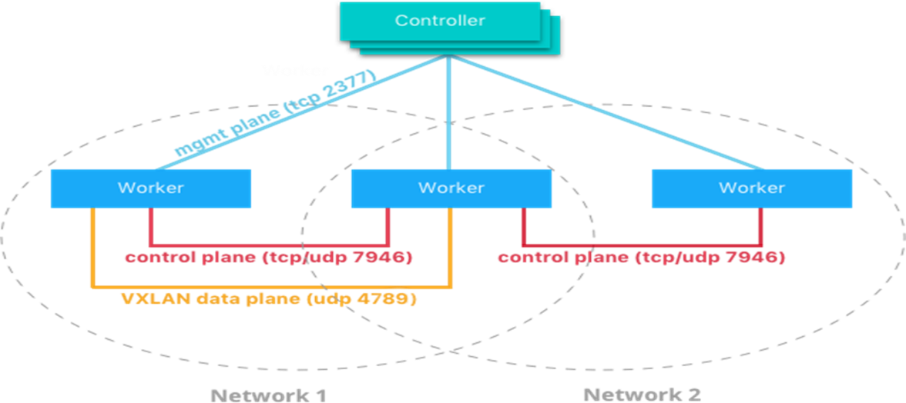
1. docker swarm란
docker swarm Network
가. Control and management plane traffic: swarm join/leave요청같은 관리트래픽으로 항상 암호화됨
나. Application data plane traffic: container 서비스를 위한 트래픽
※ SWAM NODE간 통신 포트(방화벽 OPEN필요)
TCP 2377: MASTER,WORKER간
TCP/UDP 7946: NETWORK DISCOVERY
UDP 4789 : INGRESS NETWORK
docker swarm Network
가. ingress: 서비스의 노드간 로드밸런싱을 조정하는 특수한 오버레이 네트워크로 publish된 port로 요청을 받으면 IPVS라는 모듈로 전달하고 IPVS는 서비스에 참여하는 모든 IP를 추적하고 그 중 하나를 선택하여 해당경로로 라우팅, swarm을 init/join시 자동생성
나. docker_gwbridge: 오버레이 네트워크 (수신 네트워크 포함)를 개별 Docker 데몬의 실제 네트워크에 연결하는 브리지 네트워크입니다. 기본적으로 서비스가 실행중인 각 컨테이너는 로컬 Docker 데몬 호스트의 docker_gwbridge 네트워크에 연결됩니다, swarm을 init/join시 자동생성
[root@localhost ~]# docker network ls
NETWORK ID NAME DRIVER SCOPE
b20d62c85950 bridge bridge local
81dff2efddf0 docker_gwbridge bridge local
f5805744dc61 host host local
d7ofenr9jg36 ingress overlay swarm
b206c0ee9a81 none null local

Slide 65
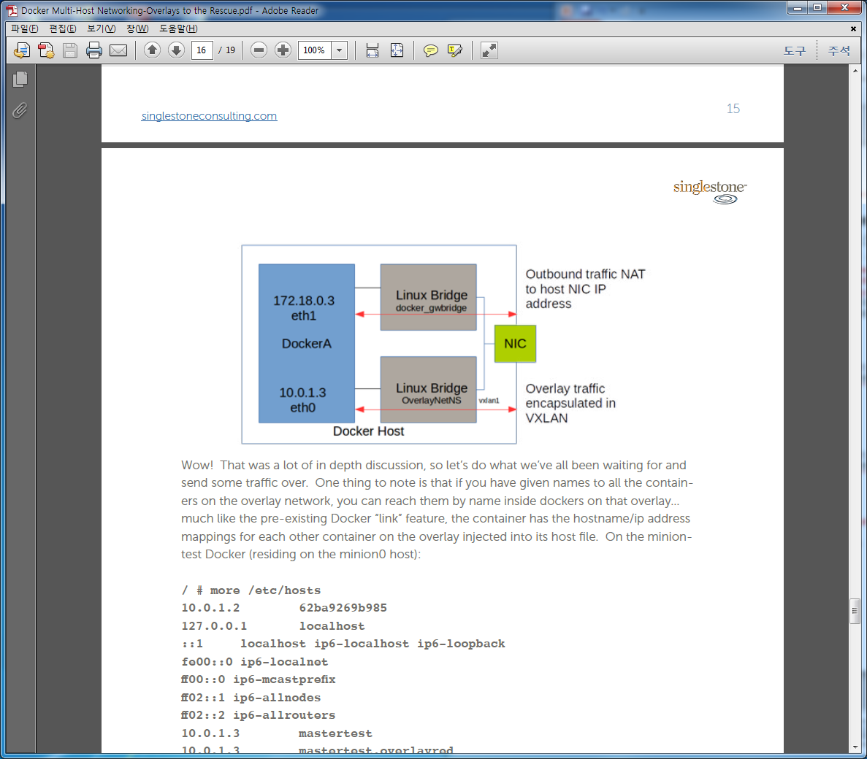
1. docker swarm란
docker swarm Network
가. PORT publish 없이 서비스만 생성 -> docker0 브릿지 사용
나. PORT publish 하는 경우 -> ingress overlay와 docker_gwbridge 사용(docker network ls의 id같음)
# docker service create --replicas 3 --name my-web -p 8080:80 httpd
[root@localhost ~]# docker exec -it b20c85fbd883 bash
root@b20c85fbd883:/usr/local/apache2# ip a
1: lo: <LOOPBACK,UP,LOWER_UP> mtu 65536 qdisc noqueue state UNKNOWN group default qlen 1
link/loopback 00:00:00:00:00:00 brd 00:00:00:00:00:00
inet 127.0.0.1/8 scope host lo
valid_lft forever preferred_lft forever
inet6 ::1/128 scope host
valid_lft forever preferred_lft forever
364: eth0@if365: <BROADCAST,MULTICAST,UP,LOWER_UP> mtu 1450 qdisc noqueue state UP group default
link/ether 02:42:0a:ff:00:07 brd ff:ff:ff:ff:ff:ff
inet 10.255.0.7/16 scope global eth0
valid_lft forever preferred_lft forever
inet 10.255.0.2/32 scope global eth0
valid_lft forever preferred_lft forever
inet6 fe80::42:aff:feff:7/64 scope link
valid_lft forever preferred_lft forever
366: eth1@if367: <BROADCAST,MULTICAST,UP,LOWER_UP> mtu 1500 qdisc noqueue state UP group default
link/ether 02:42:ac:12:00:03 brd ff:ff:ff:ff:ff:ff
inet 172.18.0.3/16 scope global eth1
valid_lft forever preferred_lft forever
inet6 fe80::42:acff:fe12:3/64 scope link
valid_lft forever preferred_lft forever
root@b20c85fbd883:/usr/local/apache2# cat /etc/hosts
127.0.0.1 localhost
::1 localhost ip6-localhost ip6-loopback
fe00::0 ip6-localnet
ff00::0 ip6-mcastprefix
ff02::1 ip6-allnodes
ff02::2 ip6-allrouters
10.255.0.7 b20c85fbd883
172.18.0.3 b20c85fbd883
ens33
10.255.0.3/16
172.18.0.2/16
docker0
(172.17.0.0/16)
docker_
gwbridge
(172.18.0.0/16)
ingress
eth0(172.18.0.3/16)
container
eth0(10.255.0.7/16)

Slide 66
1. docker swarm란
docker swarm Network
다. user define overlay 사용한 경우 -> -> ingress overlay와 docker_gwbridge와user define overlay 사용
[root@localhost ~]# docker service create --replicas 1 --name my-web --network my-network -p 8080:80 httpd
[root@localhost ~]# docker exec -it ce7937cac54e bash
root@ce7937cac54e:/usr/local/apache2# ip a
1: lo: <LOOPBACK,UP,LOWER_UP> mtu 65536 qdisc noqueue state UNKNOWN group default qlen 1
link/loopback 00:00:00:00:00:00 brd 00:00:00:00:00:00
inet 127.0.0.1/8 scope host lo
valid_lft forever preferred_lft forever
inet6 ::1/128 scope host
valid_lft forever preferred_lft forever
376: eth0@if377: <BROADCAST,MULTICAST,UP,LOWER_UP> mtu 1450 qdisc noqueue state UP group default
link/ether 02:42:0a:ff:00:05 brd ff:ff:ff:ff:ff:ff
inet 10.255.0.5/16 scope global eth0
valid_lft forever preferred_lft forever
inet 10.255.0.2/32 scope global eth0
valid_lft forever preferred_lft forever
inet6 fe80::42:aff:feff:5/64 scope link
valid_lft forever preferred_lft forever
378: eth1@if379: <BROADCAST,MULTICAST,UP,LOWER_UP> mtu 1500 qdisc noqueue state UP group default
link/ether 02:42:ac:12:00:03 brd ff:ff:ff:ff:ff:ff
inet 172.18.0.3/16 scope global eth1
valid_lft forever preferred_lft forever
inet6 fe80::42:acff:fe12:3/64 scope link
valid_lft forever preferred_lft forever
381: eth2@if382: <BROADCAST,MULTICAST,UP,LOWER_UP> mtu 1450 qdisc noqueue state UP group default
link/ether 02:42:0a:00:09:02 brd ff:ff:ff:ff:ff:ff
inet 10.0.9.2/24 scope global eth2
valid_lft forever preferred_lft forever
inet 10.0.9.1/32 scope global eth2
valid_lft forever preferred_lft forever
inet6 fe80::42:aff:fe00:902/64 scope link
valid_lft forever preferred_lft forever
root@ce7937cac54e:/usr/local/apache2# cat /etc/hosts
127.0.0.1 localhost
::1 localhost ip6-localhost ip6-loopback
fe00::0 ip6-localnet
ff00::0 ip6-mcastprefix
ff02::1 ip6-allnodes
ff02::2 ip6-allrouters
10.255.0.5 ce7937cac54e
172.18.0.3 ce7937cac54e
10.0.9.2 ce7937cac54e

Slide 67
1. docker swarm
docker swarm 설치
[root@q-nimi-os01 ~]# docker swarm init --advertise-addr 10.40.99.138
Swarm initialized: current node (5ppmtqkq7dydqxutnmre1dstb) is now a manager.
To add a worker to this swarm, run the following command:
docker swarm join \
--token SWMTKN-1-1hl0v816a0nu2cnzet10wgmhb8jfnf16nn1dgxe268fz81l25s-7rybb0wux4tx6za61hp3mlv5s \
10.40.99.138:2377
To add a manager to this swarm, run 'docker swarm join-token manager' and follow the instructions.
[root@q-chog-os01 ~]# docker swarm join --token SWMTKN-1-1hl0v816a0nu2cnzet10wgmhb8jfnf16nn1dgxe268fz81l25s-7rybb0wux4tx6za61hp3mlv5s 10.40.99.138:2377
This node joined a swarm as a worker.
[root@q-nimi-os01 ~]# docker node ls → manager node에서만 수행가능하며 hostname으로 node을 인식하므로 hostname 구분을 위해 변경필요
ID HOSTNAME STATUS AVAILABILITY MANAGER STATUS
5ppmtqkq7dydqxutnmre1dstb * q-nimi-os01.novalocal Ready Active Leader → *은 자기가 있는 node를 표시함
f3pn6ydb9ri4542abotc6nq3c q-chog-os01 Ready Active
[root@q-nimi-os01 ~]# docker info | grep Is
WARNING: Usage of loopback devices is strongly discouraged for production use. Use `--storage-opt dm.thinpooldev` to specify a custom block storage device.
Is Manager: true
[root@q-chog-os01 ~]# docker info | grep Is
WARNING: Usage of loopback devices is strongly discouraged for production use. Use `--storage-opt dm.thinpooldev` to specify a custom block storage device.
Is Manager: false

Slide 68
1. docker swarm
docker swarm service 명령어
[root@q-nimi-os01 my_wordpress]# docker service
Usage: docker service COMMAND
Manage Docker services
Options:
--help Print usage
Commands:
create Create a new service
inspect Display detailed information on one or more services
ps List the tasks of a service
ls List services
rm Remove one or more services
scale Scale one or multiple services
update Update a service

Slide 69
1. docker swarm
docker swarm 서비스 실행
[root@q-nimi-os01 ~]# docker service create --replicas 1 --name helloworld alpine ping docker.com
c70c04hnm8dbs5q8cj2g47wn8
[root@q-nimi-os01 ~]# docker service ls
ID NAME REPLICAS IMAGE COMMAND
c70c04hnm8db helloworld 1/1 alpine ping docker.com
[root@q-nimi-os01 ~]# docker service ps helloworld
ID NAME IMAGE NODE DESIRED STATE CURRE NT STATE ERROR
cfti19gs24162gskwsb8d8ce8 helloworld.1 alpine q-nimi-os01.novalocal Running Runni ng 21 seconds ago → 서비스중인 노드 확인
[root@q-nimi-os01 ~]# docker ps → 서비스 중이 노드에서 확인
CONTAINER ID IMAGE COMMAND CREATED STATUS PORTS NAMES
cdbb485680a2 alpine:latest "ping docker.com" 33 seconds ago Up 31 secon ds helloworld.1.cfti19gs24162gskwsb8d8ce8
[root@q-nimi-os01 ~]# docker service inspect --pretty helloworld
ID: c70c04hnm8dbs5q8cj2g47wn8
Name: helloworld
Mode: Replicated
Replicas: 1
Placement:
UpdateConfig:
Parallelism: 1
On failure: pause
ContainerSpec:
Image: alpine
Args: ping docker.com
Resources:
[root@q-nimi-os01 ~]# docker service inspect helloworld
[
{
"ID": "c70c04hnm8dbs5q8cj2g47wn8",
"Version": {
"Index": 18
},
"CreatedAt": "2017-05-28T04:35:07.266797477Z",
"UpdatedAt": "2017-05-28T04:35:07.266797477Z",
"Spec": {
"Name": "helloworld",
"TaskTemplate": {
"ContainerSpec": {
"Image": "alpine",
"Args": [
"ping",
"docker.com"
]
},
"Resources": {
"Limits": {},
"Reservations": {}
},
"RestartPolicy": {
"Condition": "any",
"MaxAttempts": 0
},
"Placement": {}
},
"Mode": {
"Replicated": {
"Replicas": 1
}
},
"UpdateConfig": {
"Parallelism": 1,
"FailureAction": "pause"
},
"EndpointSpec": {
"Mode": "vip"
}
},
"Endpoint": {
"Spec": {}
},
"UpdateStatus": {
"StartedAt": "0001-01-01T00:00:00Z",
"CompletedAt": "0001-01-01T00:00:00Z"
}
}
]

Slide 70
1. docker swarm
docker swarm 서비스 scale in/out
[root@q-nimi-os01 ~]# docker service scale helloworld=5
helloworld scaled to 5
[root@q-nimi-os01 ~]# docker service ls
ID NAME REPLICAS IMAGE COMMAND
c70c04hnm8db helloworld 1/5 alpine ping docker.com
[root@q-nimi-os01 ~]# docker service ls
ID NAME REPLICAS IMAGE COMMAND
c70c04hnm8db helloworld 5/5 alpine ping docker.com
[root@q-nimi-os01 ~]# docker service ps helloworld
ID NAME IMAGE NODE DESIRED STATE CURRENT STATE ERROR
cfti19gs24162gskwsb8d8ce8 helloworld.1 alpine q-nimi-os01.novalocal Running Running 4 minutes ago
936b92hxl74iewrfd7en4e9h7 helloworld.2 alpine q-nimi-os01.novalocal Running Running 39 seconds ago
ditus1sj837z3baqlss8gbteo helloworld.3 alpine q-nimi-os01.novalocal Running Running 40 seconds ago
ensas0dpw7db4j0eybwv5okdn helloworld.4 alpine q-chog-os01 Running Running 33 seconds ago
b5g255loaxz5dggwv00nlvq6m helloworld.5 alpine q-chog-os01 Running Running 33 seconds ago
[root@q-chog-os01 ~]# docker ps
CONTAINER ID IMAGE COMMAND CREATED STATUS PORTS NAMES
3ce6f428dbe7 alpine:latest "ping docker.com" About a minute ago Up About a minute helloworld.5.b5g255loaxz5dggwv00nlvq6m
618976f3ac0b alpine:latest "ping docker.com" About a minute ago Up About a minute helloworld.4.ensas0dpw7db4j0eybwv5okdn
[root@q-nimi-os01 ~]# docker service rm helloworld
helloworld
[root@q-nimi-os01 ~]# docker service ps helloworld
Error: No such service: helloworld
[root@q-nimi-os01 ~]# docker ps
CONTAINER ID IMAGE COMMAND CREATED STATUS PORTS NAMES

Slide 71
1. docker swarm
docker swarm 롤링업데이트
[root@q-nimi-os01 ~]# docker service create --replicas 3 --name redis --update-delay 10s redis:3.0.6
bh80nzttj8pubruf9qsd3v6i0
[root@q-nimi-os01 ~]# docker service ls
ID NAME REPLICAS IMAGE COMMAND
bh80nzttj8pu redis 0/3 redis:3.0.6
[root@q-nimi-os01 ~]# docker service ps redis
ID NAME IMAGE NODE DESIRED STATE CURRENT STATE ERROR
1kmsv53nyvdatqfcc8afv53kk redis.1 redis:3.0.6 q-nimi-os01.novalocal Running Preparing 17 seconds ago
3pbw4sadfrh2yg7g7ihsoz8qh redis.2 redis:3.0.6 q-chog-os01 Running Preparing 13 seconds ago
6jdy66cbfkebazqaakwpzfpg4 redis.3 redis:3.0.6 q-chog-os01 Running Preparing 13 seconds ago
[root@q-nimi-os01 ~]# docker service inspect --pretty redis
ID: bh80nzttj8pubruf9qsd3v6i0
Name: redis
Mode: Replicated
Replicas: 3
Placement:
UpdateConfig:
Parallelism: 1
Delay: 10s
On failure: pause
ContainerSpec:
Image: redis:3.0.6
Resources:
[root@q-nimi-os01 ~]# docker service update --image redis:3.0.7 redis
redis
[root@q-nimi-os01 ~]# docker service ps redis
ID NAME IMAGE NODE DESIRED STATE CURRENT STATE ERROR
e1k2u0smg5stbhmq9qanyahyz redis.1 redis:3.0.7 q-nimi-os01.novalocal Running Running 2 minutes ago
1kmsv53nyvdatqfcc8afv53kk \_ redis.1 redis:3.0.6 q-nimi-os01.novalocal Shutdown Shutdown 2 minutes ago
648sq454x3g4ppp8cgzt3ht8c redis.2 redis:3.0.7 q-nimi-os01.novalocal Running Running about a minute ago
3pbw4sadfrh2yg7g7ihsoz8qh \_ redis.2 redis:3.0.6 q-chog-os01 Shutdown Shutdown about a minute ago
8t0rdgvhe3frwcpamxopogpxz redis.3 redis:3.0.7 q-chog-os01 Running Running about a minute ago
6jdy66cbfkebazqaakwpzfpg4 \_ redis.3 redis:3.0.6 q-chog-os01 Shutdown Shutdown about a minute ago
[root@q-nimi-os01 ~]# docker service inspect --pretty redis
ID: bh80nzttj8pubruf9qsd3v6i0
Name: redis
Mode: Replicated
Replicas: 3
Update status:
State: completed
Started: 2 minutes ago
Completed: about a minute ago
Message: update completed
Placement:
UpdateConfig:
Parallelism: 1
Delay: 10s
On failure: pause
ContainerSpec:
Image: redis:3.0.7
Resources:
롤링업데이트 순서
◦Stop the first task.
◦Schedule update for the stopped task.
◦Start the container for the updated task.
◦If the update to a task returns RUNNING, wait for the specified delay period then start the next task.
◦If, at any time during the update, a task returns FAILED, pause the update

Slide 72
1. docker swarm
docker swarm 롤백
[root@q-nimi-os01 ~]# docker service update –rollback –update-delay 0s redis → 현재 버젼에서 지원하지 않음
[[root@localhost ~]# docker service update --image redis:3.0.6 redis
[root@localhost ~]# docker service ps redis
ID NAME IMAGE NODE DESIRED STATE CURRENT STATE ERROR
c1m2k6k3nr634rcb9dotqy6e6 redis.1 redis:3.0.6 localhost.localdomain Running Running less than a second ago
6uh033p3xivn2bixnnynbyci0 \_ redis.1 redis:3.0.7 localhost.localdomain Shutdown Shutdown 3 minutes ago
bhoe1djpmmi09rp7m63bs7we9 \_ redis.1 redis:3.0.6 localhost.localdomain Shutdown Shutdown less than a second ago
65c0gibce87e94m2fjd2dfqzt redis.2 redis:3.0.6 localhost.localdomain Running Running 2 minutes ago
9stbxsswvn8278wzr16a9uujy \_ redis.2 redis:3.0.7 localhost.localdomain Shutdown Shutdown less than a second ago
2iop3zgsxzh48x9hmvlbaniwf \_ redis.2 redis:3.0.6 localhost.localdomain Shutdown Shutdown 8 minutes ago
0uxz5gkh673jkxs7tyrwmt78e redis.3 redis:3.0.6 localhost.localdomain Running Running less than a second ago
b9qqjxntca64p747pt130wlrp \_ redis.3 redis:3.0.7 localhost.localdomain Shutdown Shutdown 2 minutes ago
68l0vuyxl8gosyr6z2e68w7gv \_ redis.3 redis:3.0.6 localhost.localdomain Shutdown Shutdown 8 minutes ago
※ Docker 17.04 이상에서 서비스 업데이트를 성공하지 못할 경우 자동으로 롤백되도록 서비스를 구성 할 수 있습니다

Slide 73
1. docker swarm
docker swarm drain
[[root@q-nimi-os01 ~]# docker node update --availability drain q-chog-os01 → drain(유지보수모드)로 변경시 자동으로 Active에 새로 생성됨
q-chog-os01
[root@q-nimi-os01 ~]# docker node ls
ID HOSTNAME STATUS AVAILABILITY MANAGER STATUS
5ppmtqkq7dydqxutnmre1dstb * q-nimi-os01.novalocal Ready Active Leader
f3pn6ydb9ri4542abotc6nq3c q-chog-os01 Ready Drain
[root@q-nimi-os01 ~]# docker service ps redis
ID NAME IMAGE NODE DESIRED STATE CURRENT STATE ERROR
e1k2u0smg5stbhmq9qanyahyz redis.1 redis:3.0.7 q-nimi-os01.novalocal Running Running 29 hours ago
1kmsv53nyvdatqfcc8afv53kk \_ redis.1 redis:3.0.6 q-nimi-os01.novalocal Shutdown Shutdown 29 hours ago
648sq454x3g4ppp8cgzt3ht8c redis.2 redis:3.0.7 q-nimi-os01.novalocal Running Running 29 hours ago
3pbw4sadfrh2yg7g7ihsoz8qh \_ redis.2 redis:3.0.6 q-chog-os01 Shutdown Shutdown 29 hours ago
bggik0yxocpytpzxygrtw322g redis.3 redis:3.0.7 q-nimi-os01.novalocal Running Running 16 seconds ago
8t0rdgvhe3frwcpamxopogpxz \_ redis.3 redis:3.0.7 q-chog-os01 Shutdown Shutdown 14 seconds ago
6jdy66cbfkebazqaakwpzfpg4 \_ redis.3 redis:3.0.6 q-chog-os01 Shutdown Shutdown 29 hours ago
[root@q-nimi-os01 ~]# docker node inspect --pretty q-chog-os01
ID: f3pn6ydb9ri4542abotc6nq3c
Hostname: q-chog-os01
Joined at: 2017-05-28 04:28:30.849298826 +0000 utc
Status:
State: Ready
Availability: Drain
Platform:
Operating System: linux
Architecture: x86_64
Resources:
CPUs: 2
Memory: 3.702 GiB
Plugins:
Network: bridge, host, null, overlay
Volume: local
Engine Version: 1.12.6
[root@q-nimi-os01 ~]# docker node update --availability active q-chog-os01
q-chog-os01
[root@q-nimi-os01 ~]# docker node ls
ID HOSTNAME STATUS AVAILABILITY MANAGER STATUS
5ppmtqkq7dydqxutnmre1dstb * q-nimi-os01.novalocal Ready Active Leader
f3pn6ydb9ri4542abotc6nq3c q-chog-os01 Ready Active
[root@q-nimi-os01 ~]# docker service ps redis
ID NAME IMAGE NODE DESIRED STATE CURRENT STATE ERROR
e1k2u0smg5stbhmq9qanyahyz redis.1 redis:3.0.7 q-nimi-os01.novalocal Running Running 29 hours ago
1kmsv53nyvdatqfcc8afv53kk \_ redis.1 redis:3.0.6 q-nimi-os01.novalocal Shutdown Shutdown 29 hours ago
648sq454x3g4ppp8cgzt3ht8c redis.2 redis:3.0.7 q-nimi-os01.novalocal Running Running 29 hours ago
3pbw4sadfrh2yg7g7ihsoz8qh \_ redis.2 redis:3.0.6 q-chog-os01 Shutdown Shutdown 29 hours ago
bggik0yxocpytpzxygrtw322g redis.3 redis:3.0.7 q-nimi-os01.novalocal Running Running 3 minutes ago
8t0rdgvhe3frwcpamxopogpxz \_ redis.3 redis:3.0.7 q-chog-os01 Shutdown Shutdown 3 minutes ago
6jdy66cbfkebazqaakwpzfpg4 \_ redis.3 redis:3.0.6 q-chog-os01 Shutdown Shutdown 29 hours ago

Slide 74
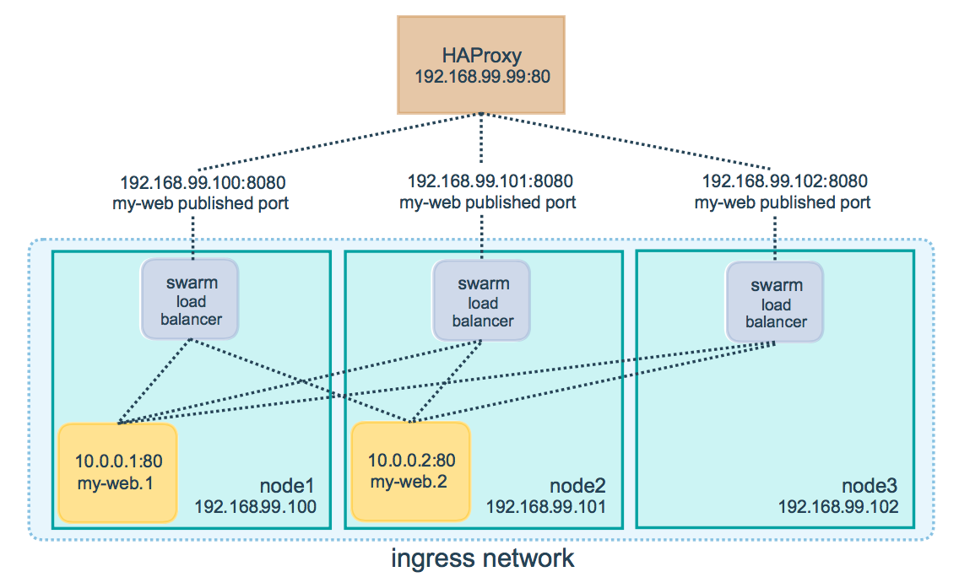
1. docker swarm
docker swarm routing mesh
routing mesh는 들어오는 모든 요청을 사용 가능한 노드에서 publish port통해 activce 컨테이너로 라우팅
ingress network로 TCP, TCP/UDP, UDP등을 매칭가능하며 로드밸런싱을 위해 HAProxy등을 일반적으로 사용
모든 노드는 사전에 다음 port가 open되 있어야함
•Port 7946 TCP/UDP for container network discovery.
•Port 4789 UDP for the container ingress network
[root@q-nimi-os01 ~]# docker service create --name my-web --publish 8080:80 --replicas 2 nginx
1olnzmxhlry7e1sm5e33jzns2
[ [root@q-nimi-os01 ~]# docker service ps my-web
ID NAME IMAGE NODE DESIRED STATE CURRENT STATE ERROR
4jrwgxfaamympp5nc1i6wof4n my-web.1 nginx q-chog-os01 Running Running 8 seconds ago
49ewqbgprtmck6hy7kq17ilc6 my-web.2 nginx q-chog-os01 Running Running 7 seconds ago
[root@q-nimi-os01 ~]# docker service inspect --format="{{json .Endpoint.Spec.Ports}}" my-web
[{"Protocol":"tcp","TargetPort":80,"PublishedPort":8080}]
global
log /dev/log local0
log /dev/log local1 notice
...snip...
# Configure HAProxy to listen on port 80
frontend http_front
bind *:80
stats uri /haproxy?stats
default_backend http_back
# Configure HAProxy to route requests to swarm nodes on port 8080
backend http_back
balance roundrobin
server node1 192.168.99.100:8080 check
server node2 192.168.99.101:8080 check
server node3 192.168.99.102:8080 check
HA proxy
docker routing mesh

Slide 75
1. docker swarm
docker swarm global
[root@q-nimi-os01 ~]# docker service create --mode=global --name prometheus prom/prometheus
8rt6pnjaw2ma2jbx9dady54es
[root@q-nimi-os01 ~]# docker service ps prometheus
ID NAME IMAGE NODE DESIRED STA TE CURRENT STATE ERROR
dmu0v9ck6ux0e2ifbswol75ee prometheus prom/prometheus q-nimi-os01.novalocal Running Preparing 8 seconds ago
4jq7ir5hti042a50sj50ajmo5 \_ prometheus prom/prometheus q-chog-os01 Running Preparing 2 seconds ago
[root@localhost ~]# docker service create --help
Usage: docker service create [OPTIONS] IMAGE [COMMAND] [ARG...]
Create a new service
Options:
--constraint value Placement constraints (default [])
--container-label value Container labels (default [])
--endpoint-mode string Endpoint mode (vip or dnsrr)
-e, --env value Set environment variables (default [])
--help Print usage
-l, --label value Service labels (default [])
--limit-cpu value Limit CPUs (default 0.000)
--limit-memory value Limit Memory (default 0 B)
--log-driver string Logging driver for service
--log-opt value Logging driver options (default [])
--mode string Service mode (replicated or global) (default "replicated") → global은 모두 node에 한개의 task실행
--mount value Attach a mount to the service
--name string Service name
--network value Network attachments (default [])
-p, --publish value Publish a port as a node port (default [])
--replicas value Number of tasks (default none)
--reserve-cpu value Reserve CPUs (default 0.000)
--reserve-memory value Reserve Memory (default 0 B)
--restart-condition string Restart when condition is met (none, on-failure, or any)
--restart-delay value Delay between restart attempts (default none)
--restart-max-attempts value Maximum number of restarts before giving up (default none)
--restart-window value Window used to evaluate the restart policy (default none)
--stop-grace-period value Time to wait before force killing a container (default none)
--update-delay duration Delay between updates (default 0s)
--update-failure-action string Action on update failure (pause|continue) (default "pause")
--update-parallelism uint Maximum number of tasks updated simultaneously (0 to update all at once) (default 1)
-u, --user string Username or UID
--with-registry-auth Send registry authentication details to swarm agents
-w, --workdir string Working directory inside the container

Slide 76
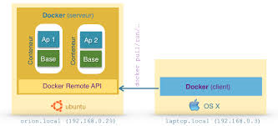
기타. docker Remote API
docker Remote API
Docker SDK를 사용하면 Docker Engine을 제어하고 관리 할 수있는 응용 프로그램을 작성할 수 있습니다.
Docker Engine API를위한 인터페이스이지만, API로 더 쉽게 작업 할 수있게 해주는 많은 툴을 포함하고 있습니다. Python과 Go에서 사용할 수있는 공식 라이브러리가 있으며 다른 언어를 지원하는 많은 커뮤니티 지원 라이브러리가 있습니다.
Python | import docker client = docker.from_env() print client.containers.run("alpine", ["echo", "hello", "world"])
Curl | $ curl --unix-socket /var/run/docker.sock -H "Content-Type: application/json" \ -d '{"Image": "alpine", "Cmd": ["echo", "hello world"]}' \ -X POST http:/v1.24/containers/create {"Id":"1c6594faf5","Warnings":null} $ curl --unix-socket /var/run/docker.sock -X POST http:/v1.24/containers/1c6594faf5/start $ curl --unix-socket /var/run/docker.sock -X POST http:/v1.24/containers/1c6594faf5/wait {"StatusCode":0} $ curl --unix-socket /var/run/docker.sock "http:/v1.24/containers/1c6594faf5/logs?stdout=1" hello world

Slide 77
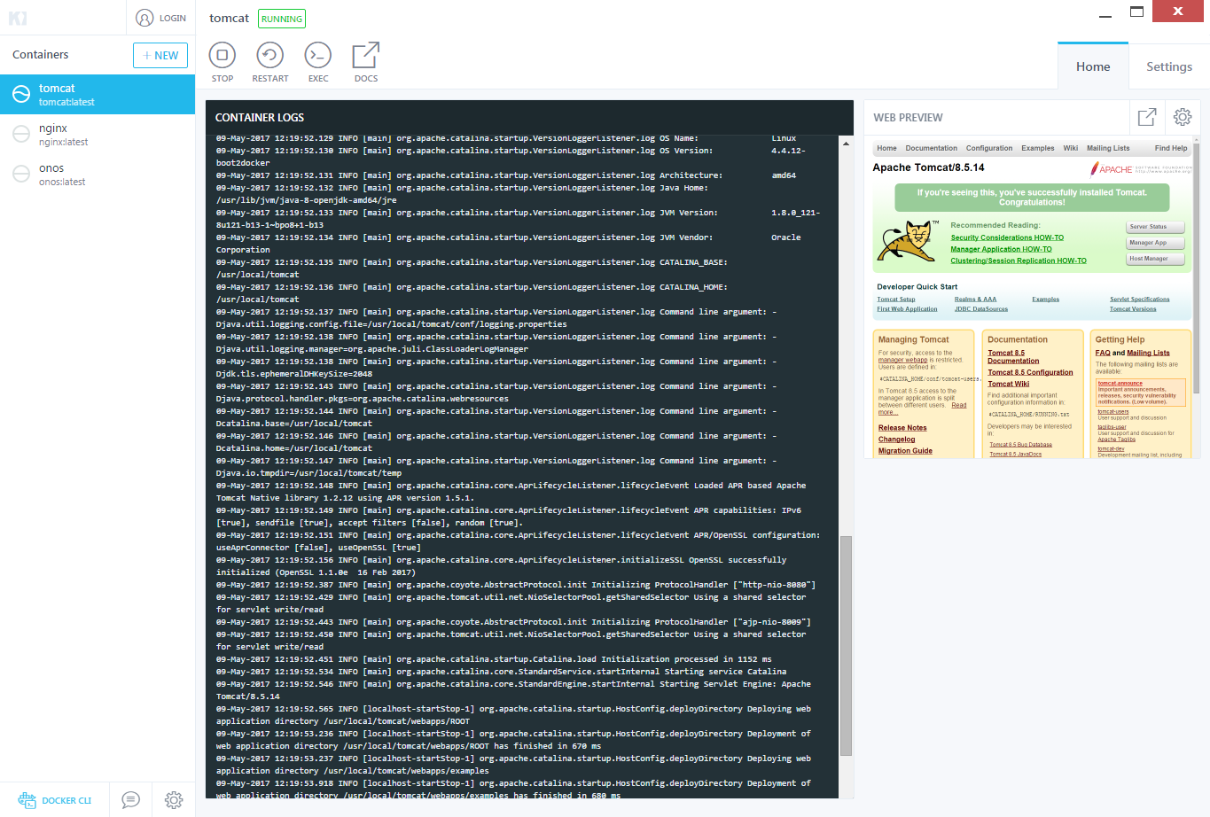
기타. docker
윈도우에서 docker 사용하기(docker toolbox설치)
- Kitematic : virtualbox에서 linux VM 실행
- Docker Quickstart Terminal : linux VM CLI접속
- EXEC 실행시 Container 내부접속

Slide 78
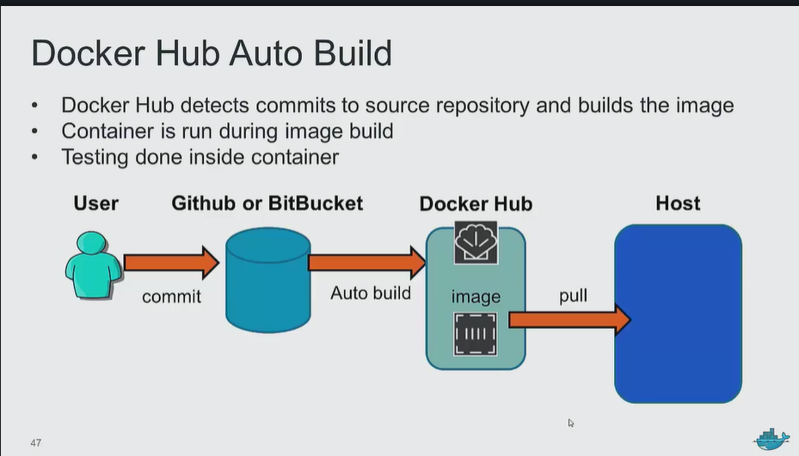
기타. docker
docker Auto build
ㅇ git hub/bitbucket과 연계하여 사용자가 변경된 내용이 자동으로 docker hub에 반영됨
ㅇ docker hub의 repository에 autobuild 여부 표시됨
ㅇ 적용될 HOST에 docker pull로 적용

